Slide 1
PLL’s and Phase Noise Modeling in Verilog
Greg Warwar
May 22, 2018

Slide 2
Outline
  Matrix based circuit solvers
  Clocks and oscillators
  Implementing an oscillator in Verilog
  Implementing an oscillator in Verilog with jitter
  Simulating oscillators in SPICE/Spectre/Eldo
    Accuracy, Simulation Time, Verilog-A, Simulation tool differences
  Phase Lock Loop example in Verilog

Slide 3
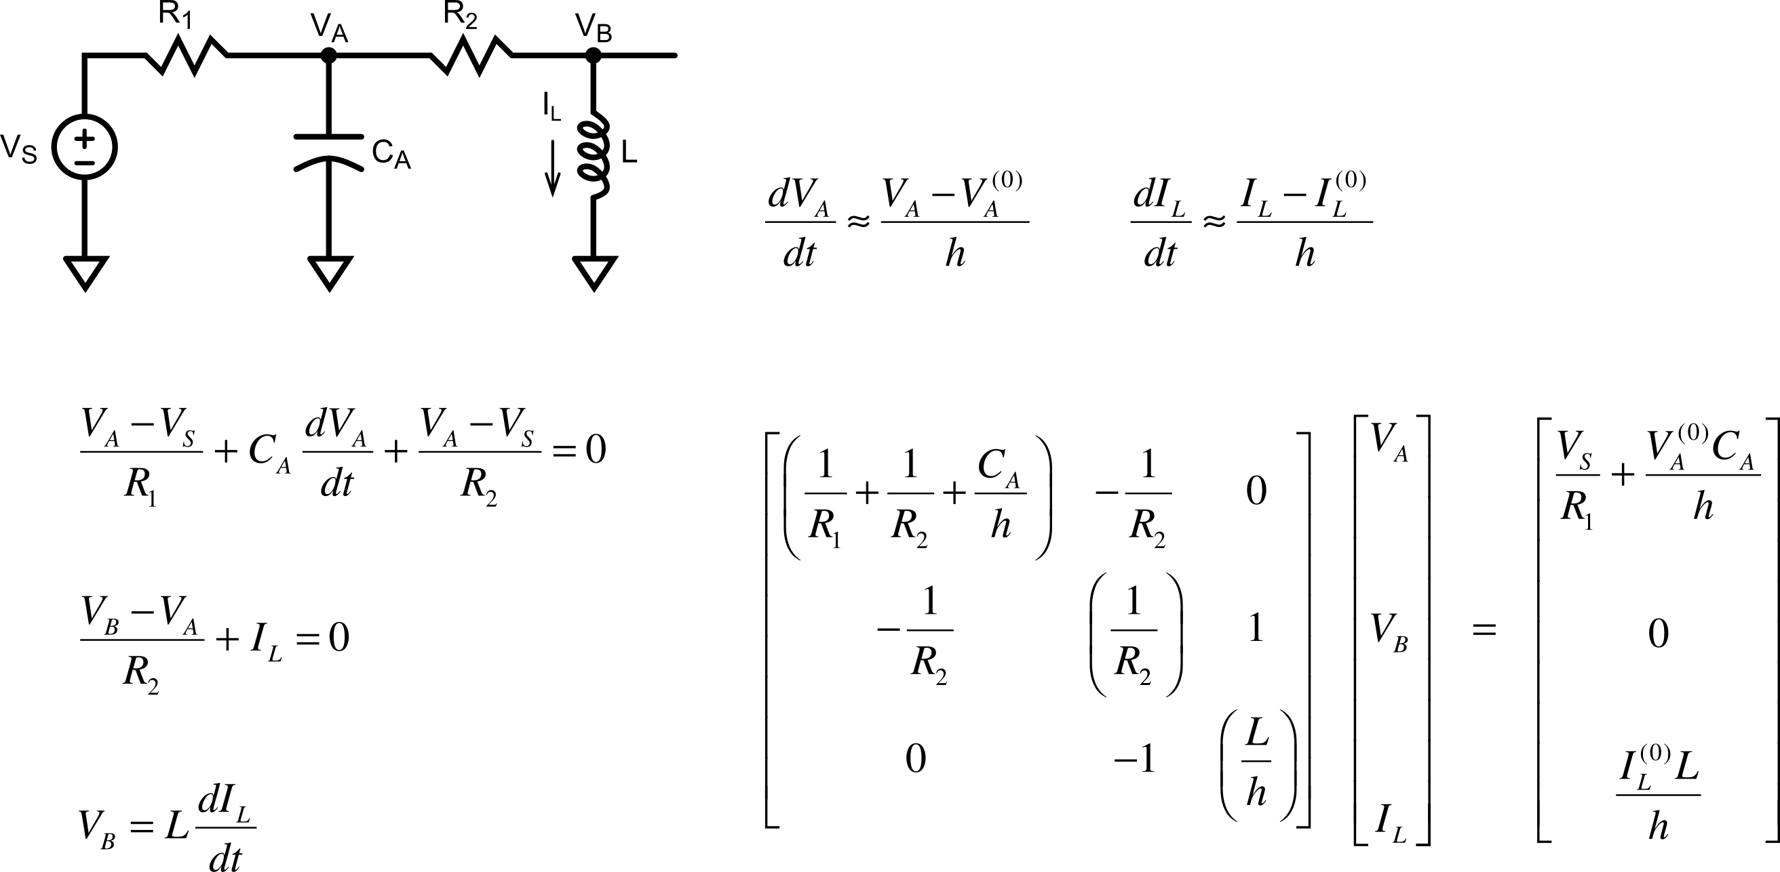
SPICE Circuit Analysis – 3 “nodes”

Slide 4
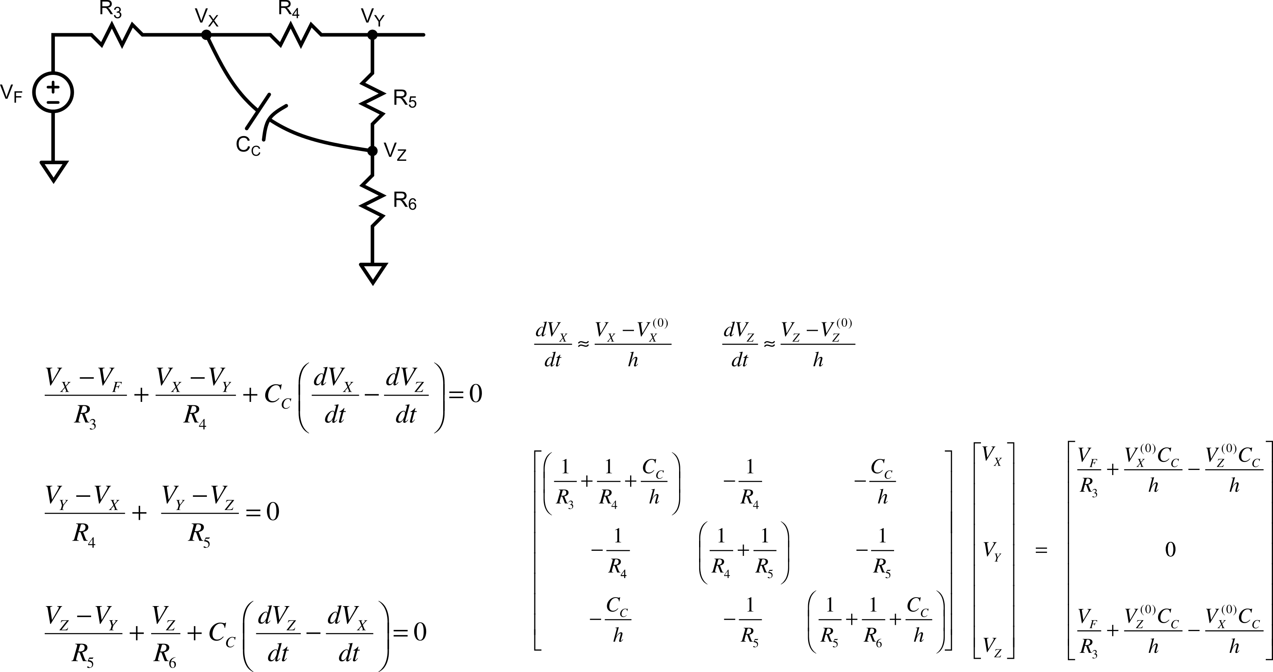
SPICE – Another 3-“node” Circuit

Slide 5
SPICE – Another 3-“node” Circuit
Tolerance settings determine size of “h”
Tolerance also determine accuracy of non-linear elements

Slide 6
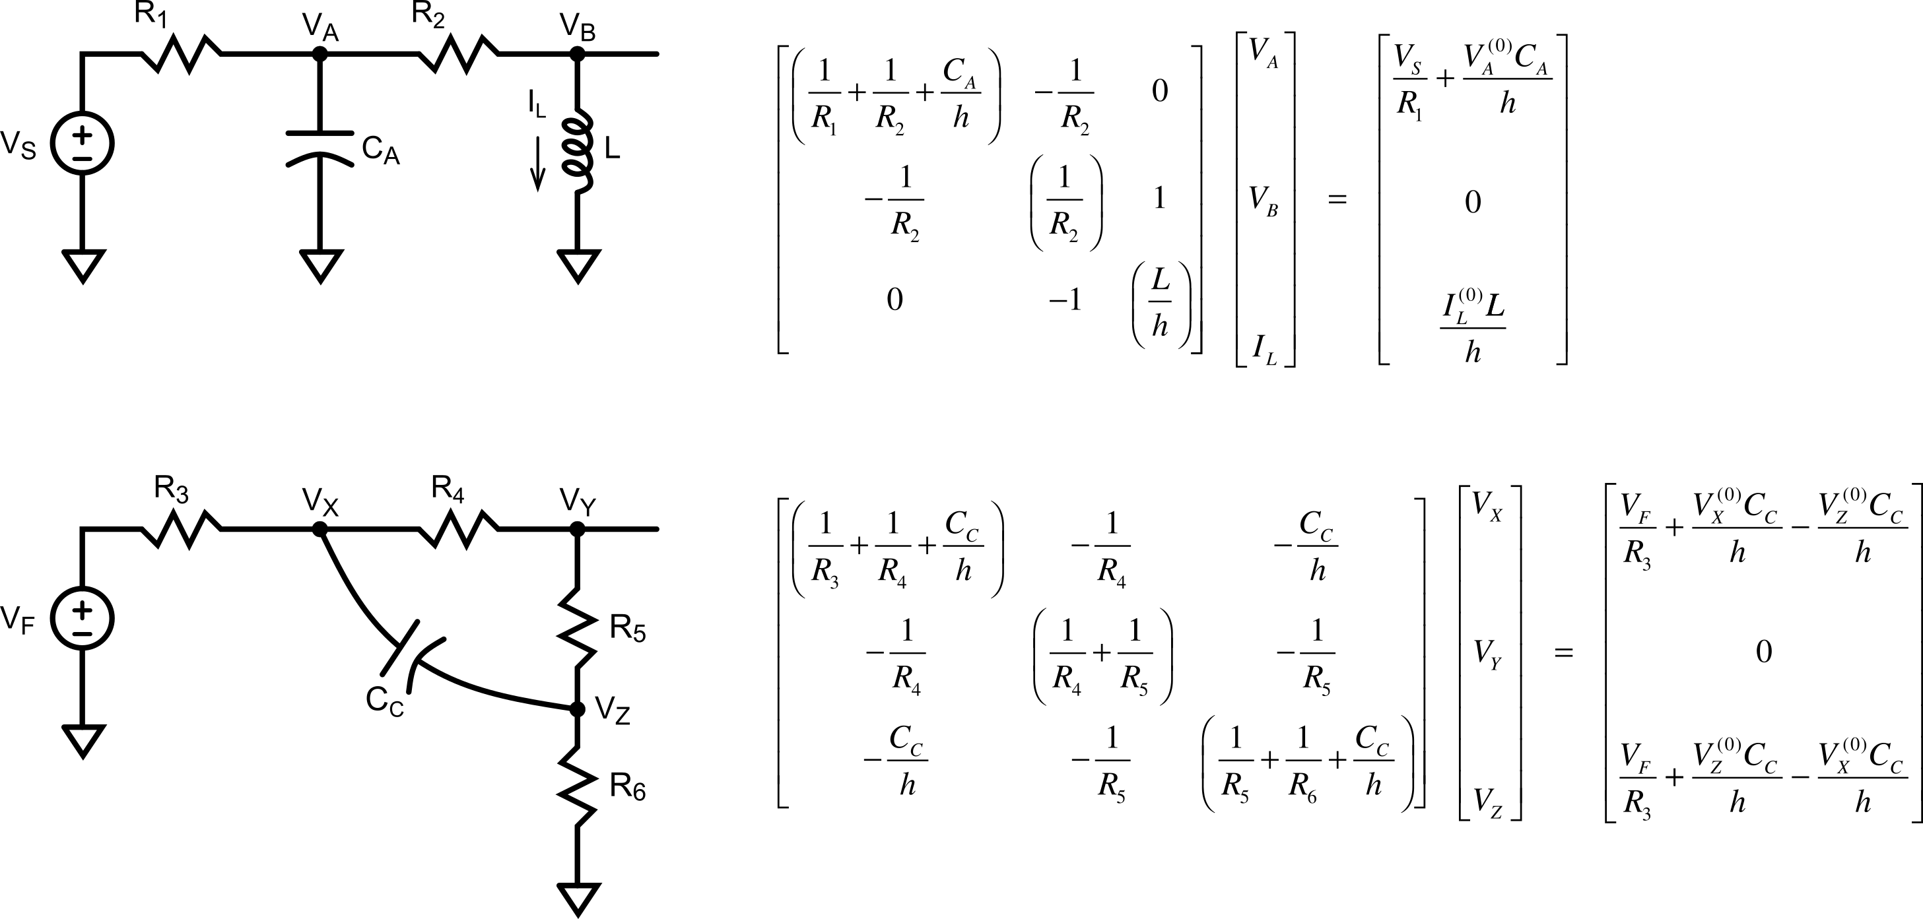
SPICE: Two Non-Coupled Circuits

Slide 7
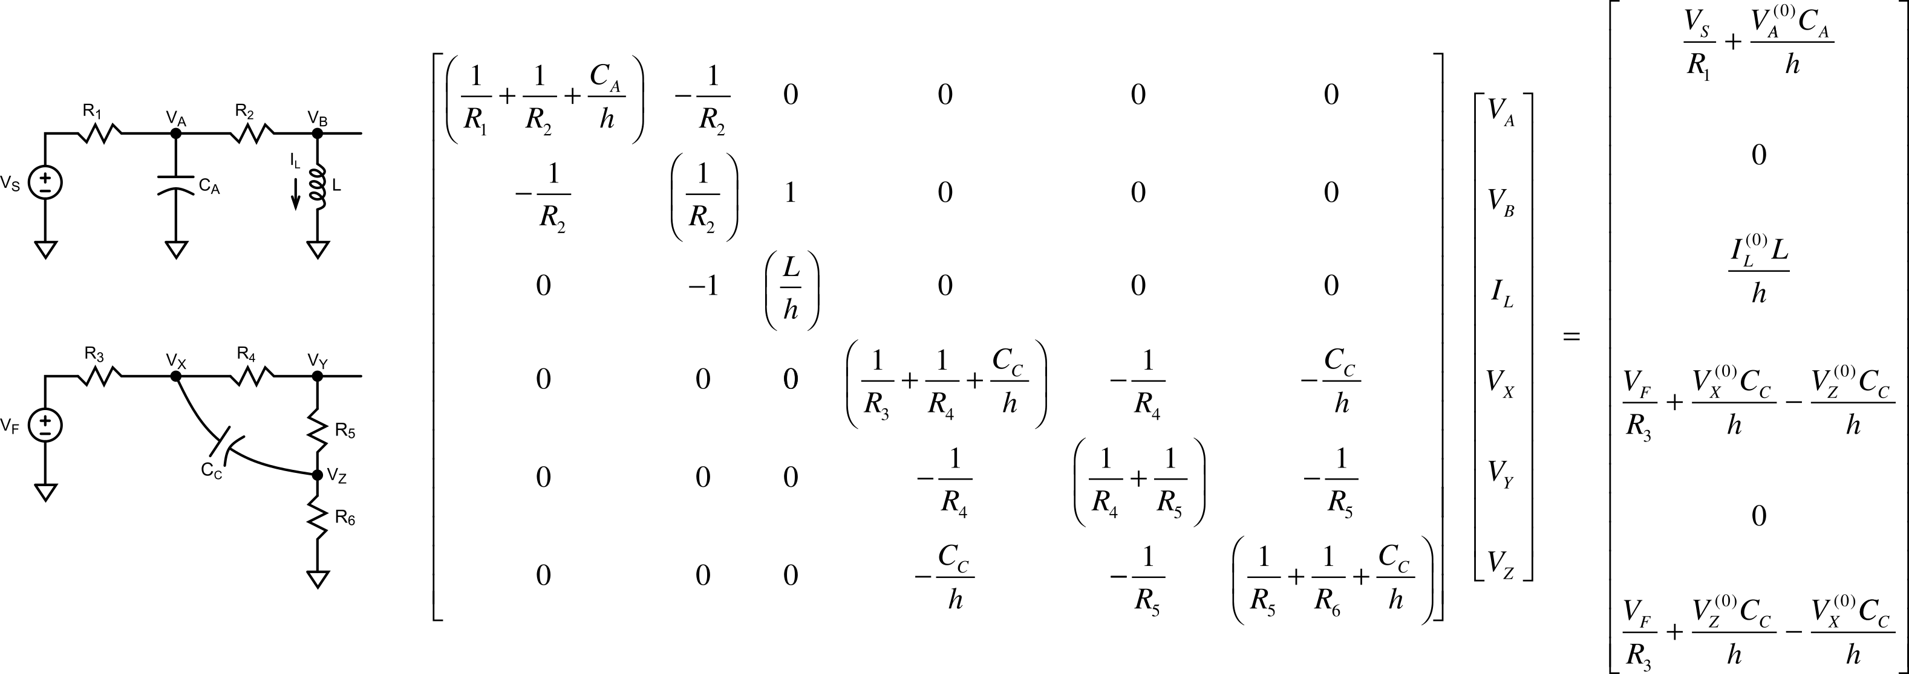
SPICE: Two Non-Coupled Circuits – Combined Matrix

Slide 8
SPICE: Two Non-Coupled Circuits – Combined Matrix
Zeros “fill in” as maxtrix is solved
Uncoupled equations become coupled via numerical roundoff / noise

Slide 9
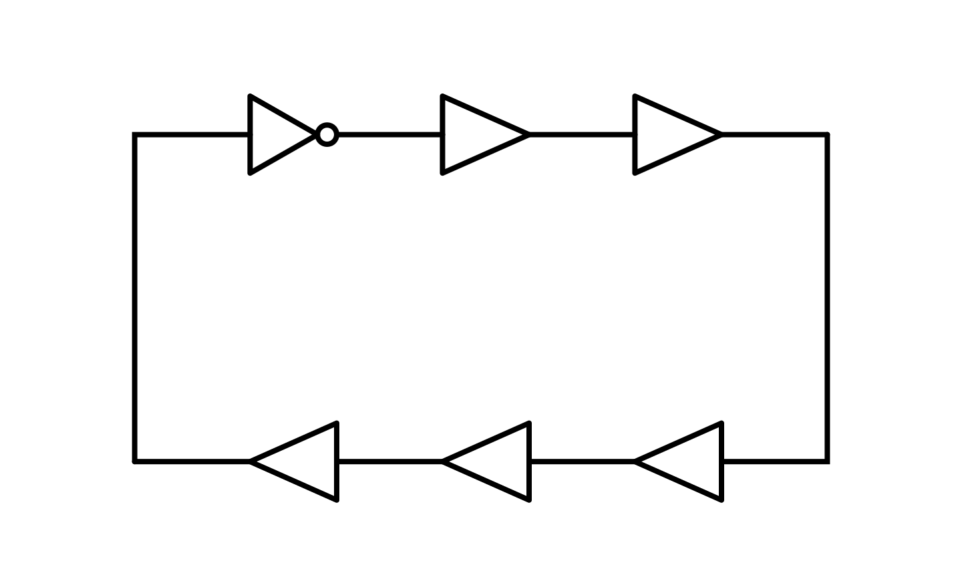
Oscillators
Delay around ring one time is (6 D)
One period requires going around the ring twice → T = 12 D
The frequency of the oscillator is → f = 1/T
The ring requires an odd number of inversions

Slide 10
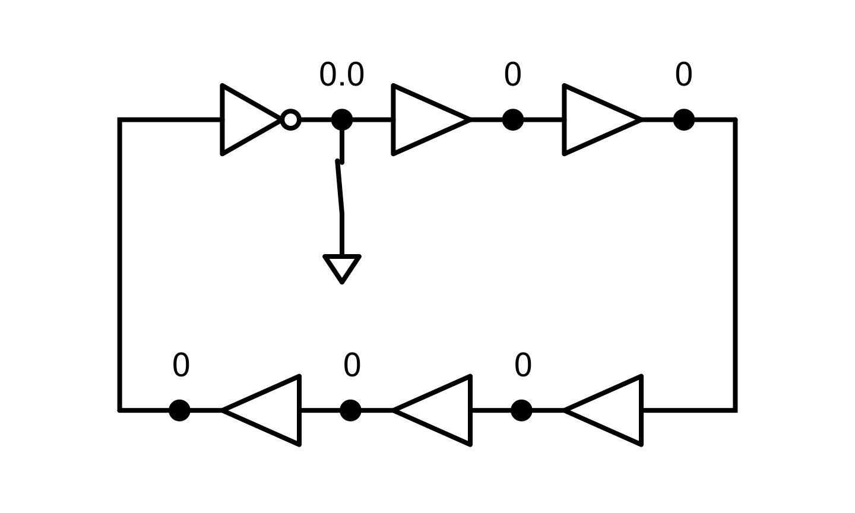
Oscillators
Force an initial condition
Delay around ring one time is (6 D)
One period requires going around the ring twice → T = 12 D
The frequency of the oscillator is → f = 1/T
The ring requires an odd number of inversions

Slide 11
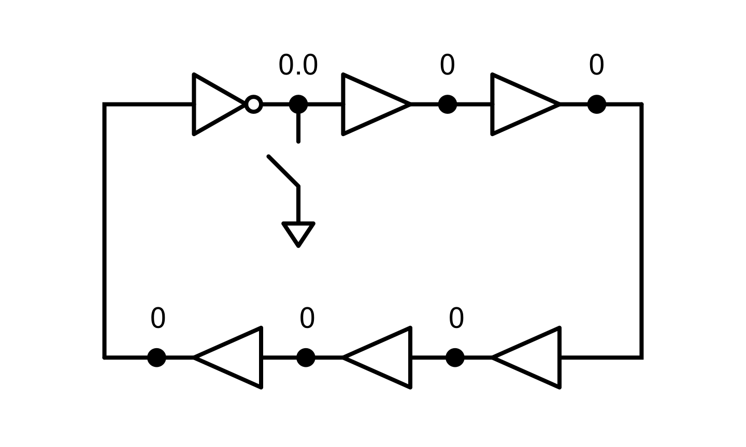
Oscillators – Open Switch 0
Open Switch – signal starts propagating
Delay around ring one time is (6 D)
One period requires going around the ring twice → T = 12 D
The frequency of the oscillator is → f = 1/T
The ring requires an odd number of inversions

Slide 12

Oscillators – Open Switch 1
Open Switch – signal starts propagating
Delay around ring one time is (6 D)
One period requires going around the ring twice → T = 12 D
The frequency of the oscillator is → f = 1/T
The ring requires an odd number of inversions

Slide 13

Oscillators – Open Switch 2
Open Switch – signal starts propagating
Delay around ring one time is (6 D)
One period requires going around the ring twice → T = 12 D
The frequency of the oscillator is → f = 1/T
The ring requires an odd number of inversions

Slide 14

Oscillators – Open Switch 3
Open Switch – signal starts propagating
Delay around ring one time is (6 D)
One period requires going around the ring twice → T = 12 D
The frequency of the oscillator is → f = 1/T
The ring requires an odd number of inversions

Slide 15

Oscillators – Open Switch 4
Open Switch – signal starts propagating
Delay around ring one time is (6 D)
One period requires going around the ring twice → T = 12 D
The frequency of the oscillator is → f = 1/T
The ring requires an odd number of inversions

Slide 16
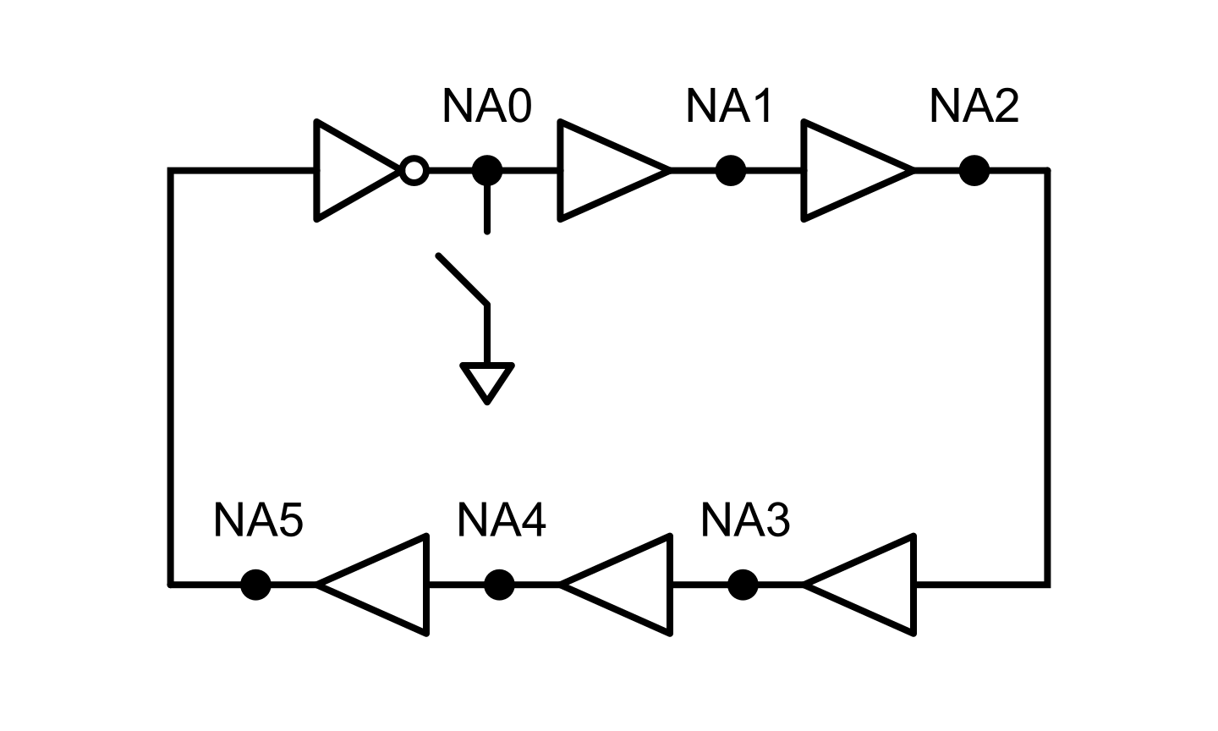
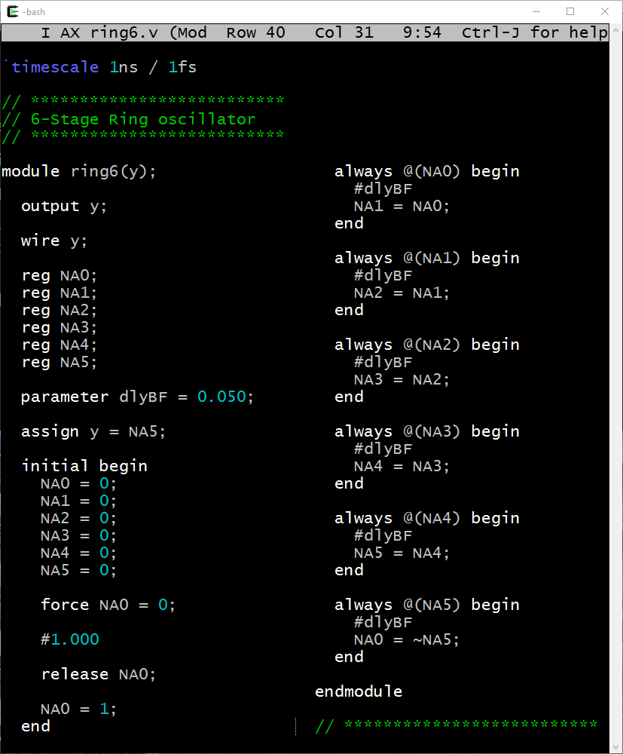
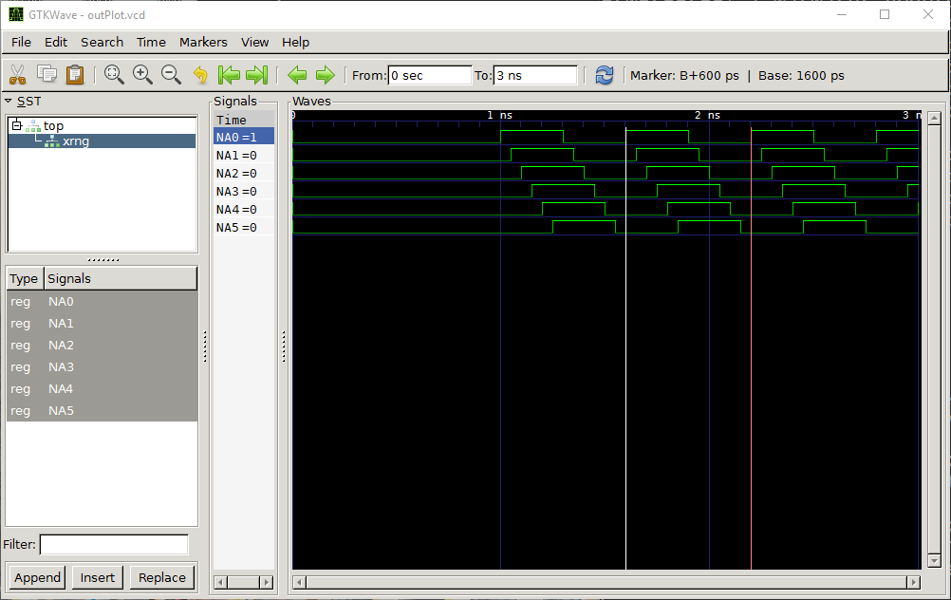
Oscillators – How do we simulate in Verilog
50ps
D
D
D
D

Slide 17
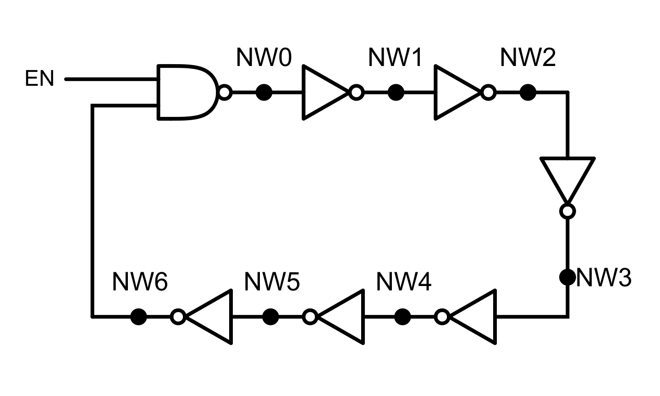
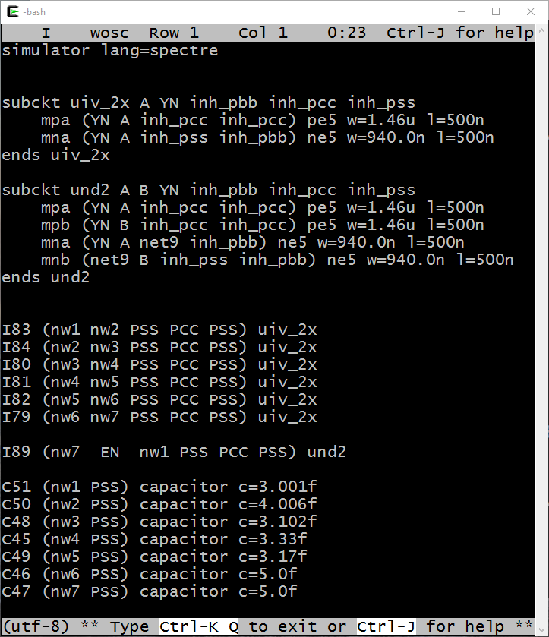
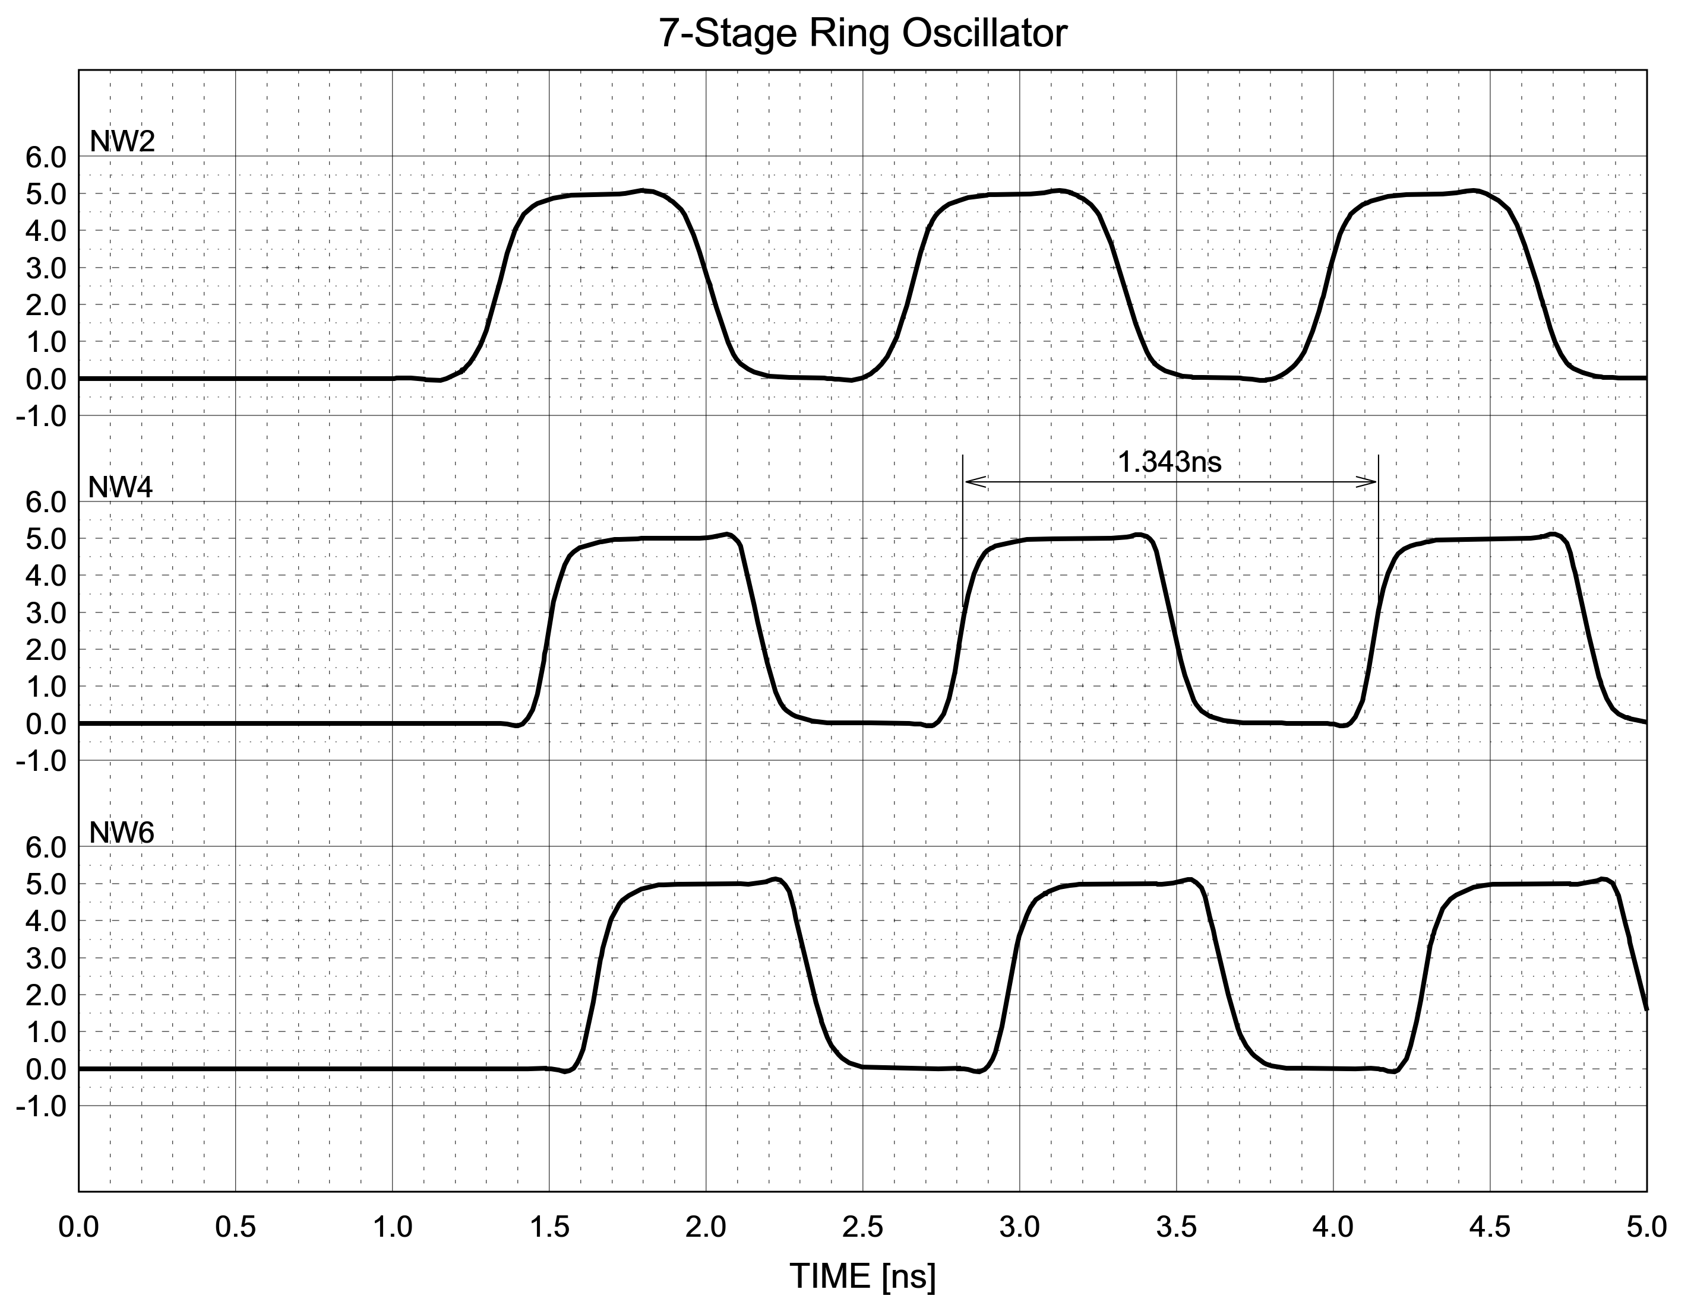
Oscillators – How do we simulate in SPICE
~100ps

Slide 18
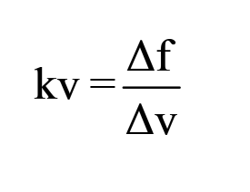
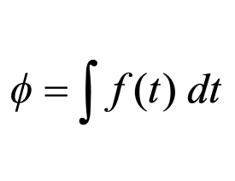
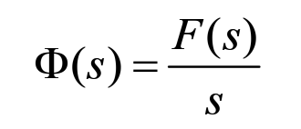
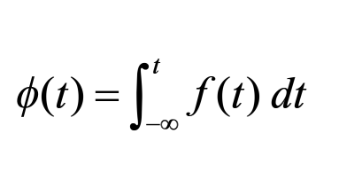
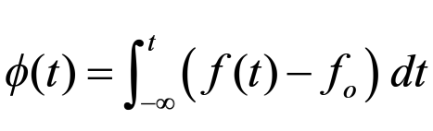
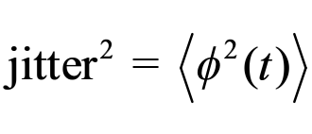
Oscillators – Key Properties
Frequency
  Center frequency → f_{o}
  Frequency range → f_{max} – f_{min}
  Frequency vs. Control_Voltage → kv [GHz/V]
Phase
  Phase is the delay of a clock relative to an ideal master
  Phase is measured in [ps], [deg], [rad], [periods]
  Phase is the integral of frequency
Jitter
  Jitter is variation of the phase with time
  Jitter is key performance metric of a precision clock

Slide 19
Oscillators – (Before Adding Jitter)
50ps
D
D
D
D

Slide 20
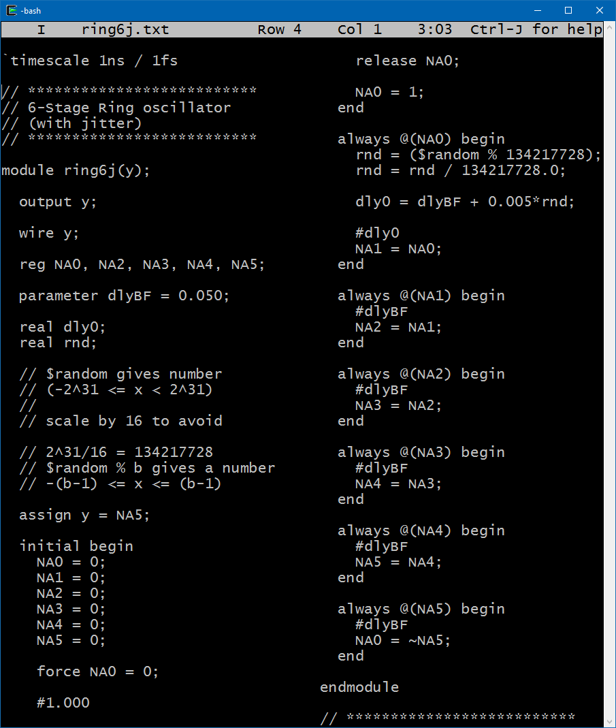
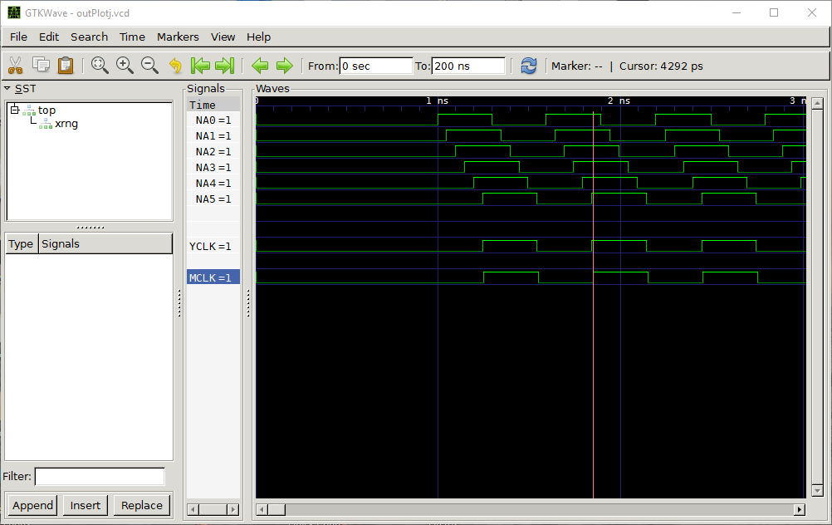
Oscillators – Add Simple Jitter in Verilog – (t = 0)
50ps
D
D
D
D

Slide 21
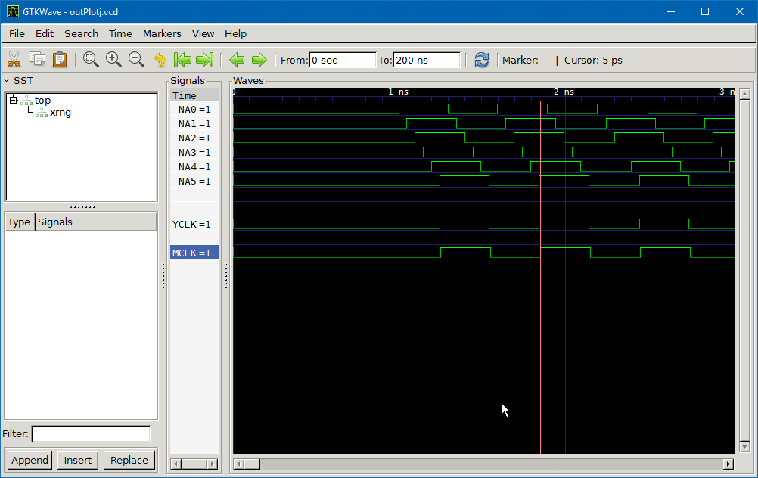
Oscillators – Add Simple Jitter in Verilog – (0 < t < 200n)
50ps
D
D
D
D

Slide 22
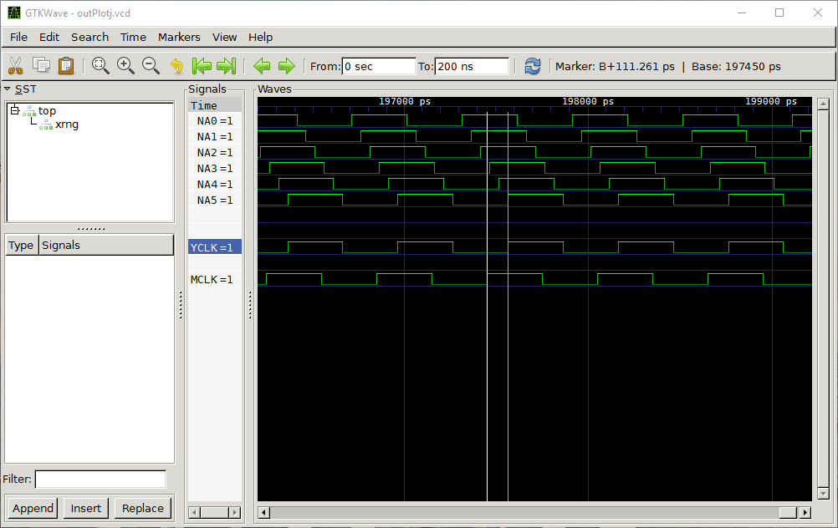
Oscillators – Add Simple Jitter in Verilog – (t = 200n)
50ps
D
D
D
D

Slide 23
Oscillators – Add Simple Jitter in Verilog – (0 < t < 200n)
D
D
D
D

Slide 24
Why not just use SPICE??
  Isn’t it more accurate?
  Can’t you just put some blocks in “Verilog-A” and go fast?

Slide 25
Why do we simulate PLL’s and Clocks??
  Study initialization and other transient conditions
  Study interfaces between asynchronous clock domains
    FIFO’s, clock phase alignment circuits
  Study PLL’s in the time domain
    Instability, or “run-away” problems due to nonlinear elements
    Clock recovery circuits with nonlinear control loops
  Verification of top level designs containing PLL’s
  Study jitter generation and propagation

Slide 26
Intermission - Find your inner self
  Am I an analog or digital guy / gal?

Slide 27
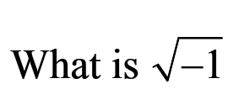
Intermission - Find your inner self #1

Slide 28
Intermission - Find your inner self #1
  j → +1 point Analog

Slide 29
Intermission - Find your inner self #1
  j → +1 point Analog
  i → +1 point Digital

Slide 30
Intermission - Find your inner self #1
  j → +1 point Analog
  i → +1 point Digital
  ERROR → +2 points Digital

Slide 31
Intermission - Find your inner self #1
  j → +1 point Analog
  i → +1 point Digital
  ERROR → +2 points Digital
  90° → +2 points Analog

Slide 32
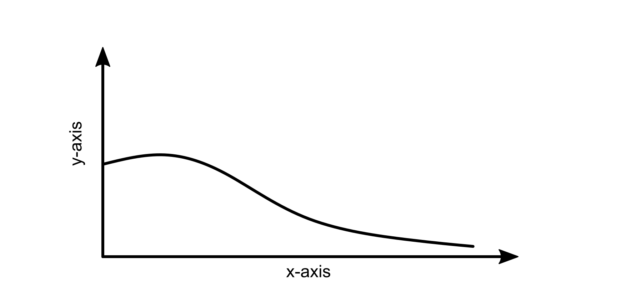
Intermission - Find your inner self #2
What is the x-axis?

Slide 33
Intermission - Find your inner self #2
  frequency → +1 point Analog
What is the x-axis?

Slide 34
Intermission - Find your inner self #2
  frequency → +1 point Analog
  time → +1 point Digital
What is the x-axis?

Slide 35
Intermission - Find your inner self #2
  frequency → +1 point Analog
  time → +1 point Digital
  cycle → +2 points Digital
What is the x-axis?

Slide 36
Intermission - Find your inner self #3
What is the units of y-axis?

Slide 37
Intermission - Find your inner self #3
  dB → +1 point Analog
  volts → +1 point Digital
  → +2 points Digital
What is the units of y-axis?
Anything you can count
Errors, hits, collisions, …

Slide 38
Intermission - Find your inner self #4
If (x == 8.3) {
.
.
.
}
What’s wrong with this code?

Slide 39
Intermission - Find your inner self #4
  Nothing → +1 point Analog
If (x == 8.3) {
.
.
.
}
What’s wrong with this code?

Slide 40
Intermission - Find your inner self #4
  Nothing → +1 point Analog
  → +1 point Digital
If (x == 8.3) {
.
.
.
}
What’s wrong with this code?
Internal
Roundoff

Slide 41
Why not just use SPICE??
  Isn’t it more accurate?
  Can’t you just put some blocks in “Verilog-A” and go fast?

Slide 42
Why do we simulate PLL’s and Clocks??
  Study initialization and other transient conditions
  Study interfaces between asynchronous clock domains
    FIFO’s, clock phase alignment circuits
  Study PLL’s in the time domain
    Instability, or “run-away” problems due to nonlinear elements
    Clock recovery circuits with nonlinear control loops
  Verification of top level designs containing PLL’s
  Study jitter generation and propagation

Slide 43
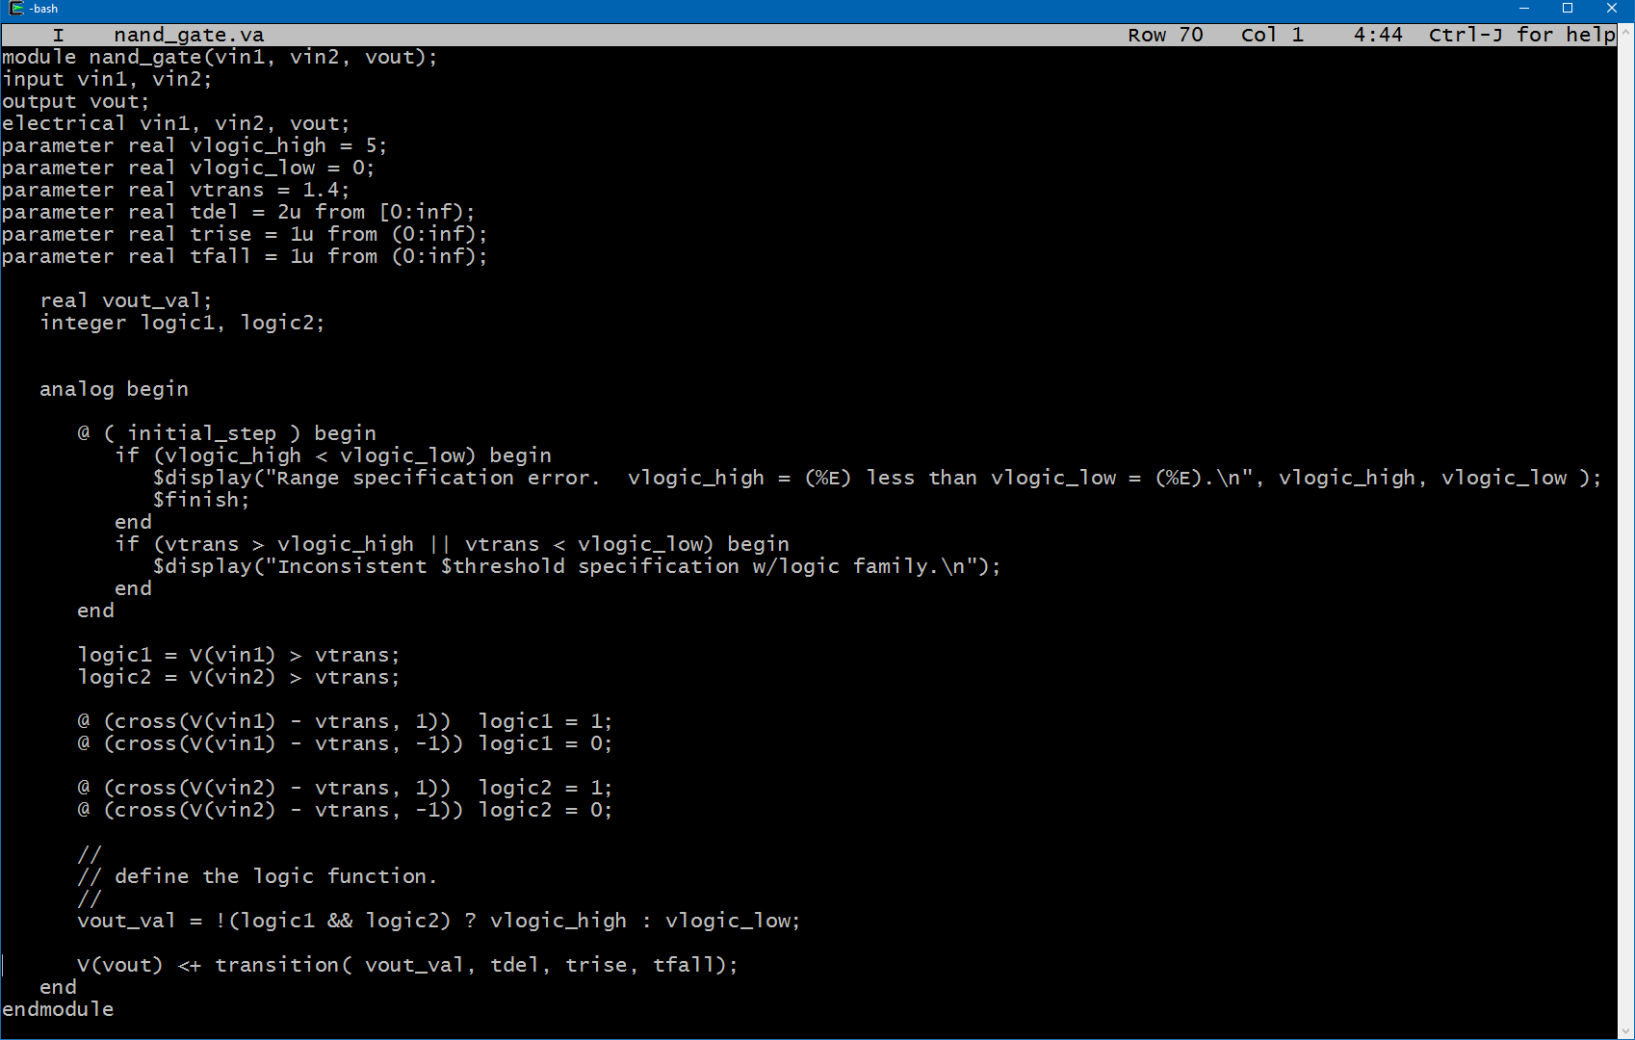
What about Verilog-A ????
Looks like Verilog
Language supports triggered events

Slide 44
What about Verilog-A ????
Looks like Verilog
Language supports triggered events
Still has to be resolved down to a matrix!!!

Slide 45
Oscillators – Accuracy in SPICE / Spectre / Eldo
Benchmark Test
Run 11us
Measure total jitter for (1us < t < 10us)
Tolerance → [conservative, moderate, liberal]
~100ps

Slide 46
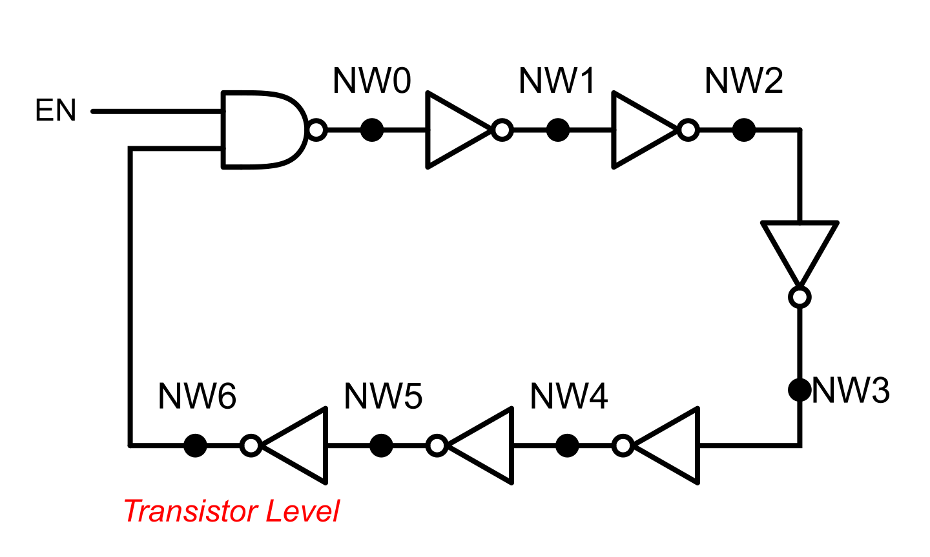

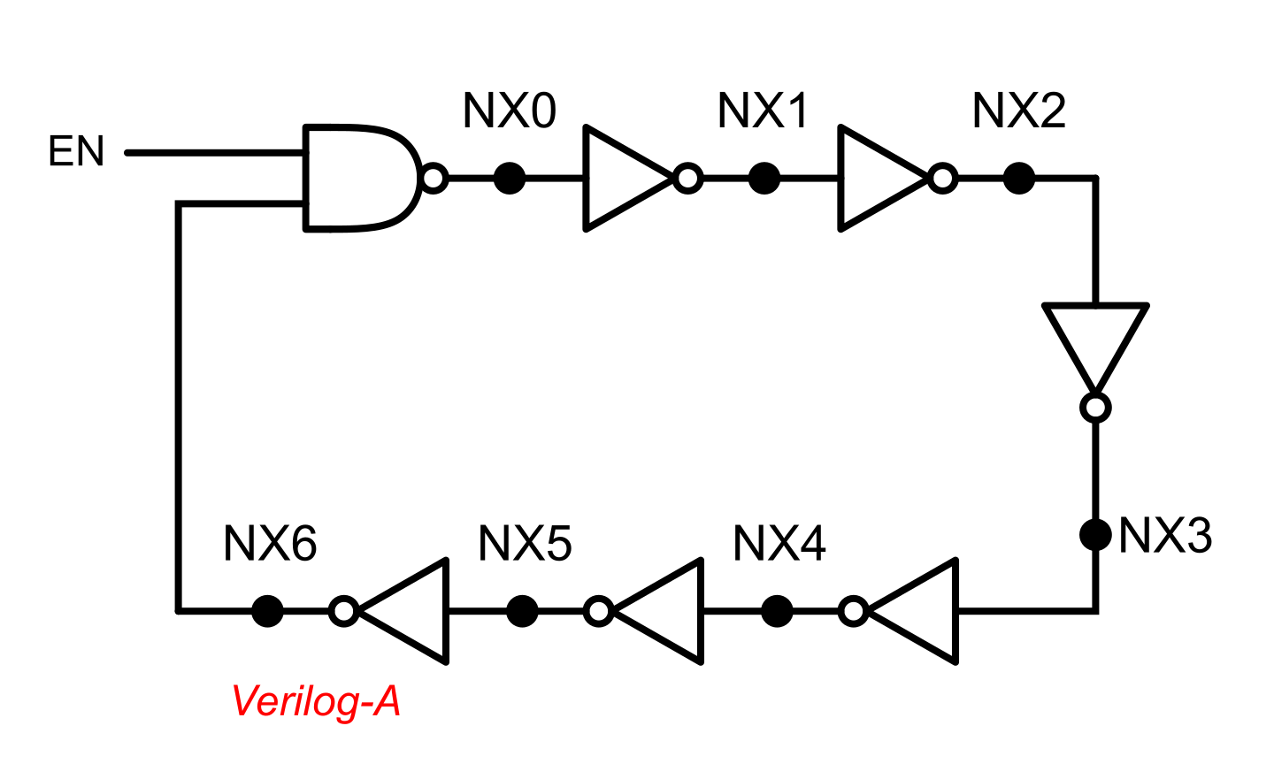

Oscillators – Accuracy in Eldo - 1
~100ps
F = 7.489851e+08
J = 2.916330e-16
T = 0-min 50-sec

Slide 47
Oscillators – Accuracy in Eldo - 4
~100ps
F = 7.301669e+08
J = 9.534742e-17
T = 2-min 25-sec

Slide 48
Oscillators – Accuracy in Eldo - 7
~100ps
F = 7.572305e+08
J = 1.427320e-11
T = 5-min 10-sec*
F = 7.316815e+08
J = 9.628039e-11
T = 5-min 10-sec*

Slide 49
Oscillators – Accuracy in Eldo - 8
~100ps
F = 7.583032e+08
J = 2.905199e-11
T = 12-min 6-sec*
F = 7.591970e+08
J = 2.556108e-11
T = 12-min 6-sec*
F = 7.369350e+08
J = 1.422838e-10
T = 12-min 6-sec*
F = 7.681427e+08
J = 1.590278e-10
T = 12-min 6-sec*

Slide 50
Oscillators – Accuracy in Spectre - 1
~100ps
F = 7.530338e+08
J = 2.281258e-12
T = 2-min 18-sec

Slide 51
Oscillators – Accuracy in Spectre - 2
~100ps
F = 7.538988e+08
J = 1.401772e-12
T = 2-min 18-sec

Slide 52
Oscillators – Accuracy in Spectre - 3
~100ps
F = 7.532945e+08
J = 1.346296e-11
T = 4-min 23-sec*
F = 7.540933e+08
J = 1.108888e-11
T = 4-min 23-sec*

Slide 53
Oscillators – Accuracy in Spectre - 4
~100ps
F = 7.697708e+08
J = 5.517425e-18
T = 0-min 49-sec

Slide 54
Oscillators – Accuracy in Spectre - 5
~100ps
F = 8.067968e+08
J = 3.129376e-18
T = 0-min 58-sec

Slide 55
Oscillators – Accuracy in Spectre - 6
~100ps
F = 7.697708e+08
J = 5.501316e-15
T = 1-min 56-sec*
F = 8.067968e+08
J = 1.626288e-15
T = 1-min 56-sec*

Slide 56
Oscillators – Accuracy in Spectre - 7
~100ps
F = 7.551702e+08
J = 6.855988e-13
T = 4-min 47-sec*
F = 7.697708e+08
J = 2.811061e-15
T = 4-min 47-sec*

Slide 57
Oscillators – Accuracy in Spectre - 8
~100ps
F = 7.558547e+08
J = 9.740328e-12
T = 11-min 5-sec*
F = 7.567189e+08
J = 7.581477e-12
T = 11-min 5-sec*
F = 7.697708e+08
J = 7.345695e-15
T = 11-min 5-sec*
F = 8.067968e+08
J = 3.472637e-15
T = 11-min 5-sec*

Slide 58
Eldo / Spectre Summary
Eldo has more trouble with Verilog-A
  Verilog-A ~ 3x slower than transistors !!!
  Timing accuracy of Verilog-A is essentially broken
Spectre has better handling of Verilog-A
  Verilog-A ~ 2x faster than transistors
  Timing accuracy of Verilog-A is realiable
  Presence of Verilog-A cells degrades accuracy transistors

Slide 59
Simulator Types
  Verilog is an event driven simulator
    Time is internally stored as a 64-bit integer.
    `timestep 1ns/1fs
      This indicates that each LSB of time is 1fs
      The user unit of time is 1ns, but internally this is unimportant.
  All events are “snapped” to a simulator time unit.
    Other than “snapping”, no roundoff or numerical error in time calculation
  Spectre, Eldo, HSPICE, (Verilog-A) are timestep simulators
    Timestep simulators do not solve equations exactly
    Iterate until (error < “vntol”)

Slide 60
Data Types in Verilog
  Time is interally stored as 64-bit integer
    Using 1fs time unit, the largest time possible
      2^64*1fs = 18446 seconds = 5 hr – 7min
  Integers are 32-bit
  Reals and Parameter are double-precision
    ~ 16-digits > 300dB dynamic range
  Use Reals where necessary to avoid “time snapping”
    Especially important in VCO’s and clock sources !!!!

Slide 61
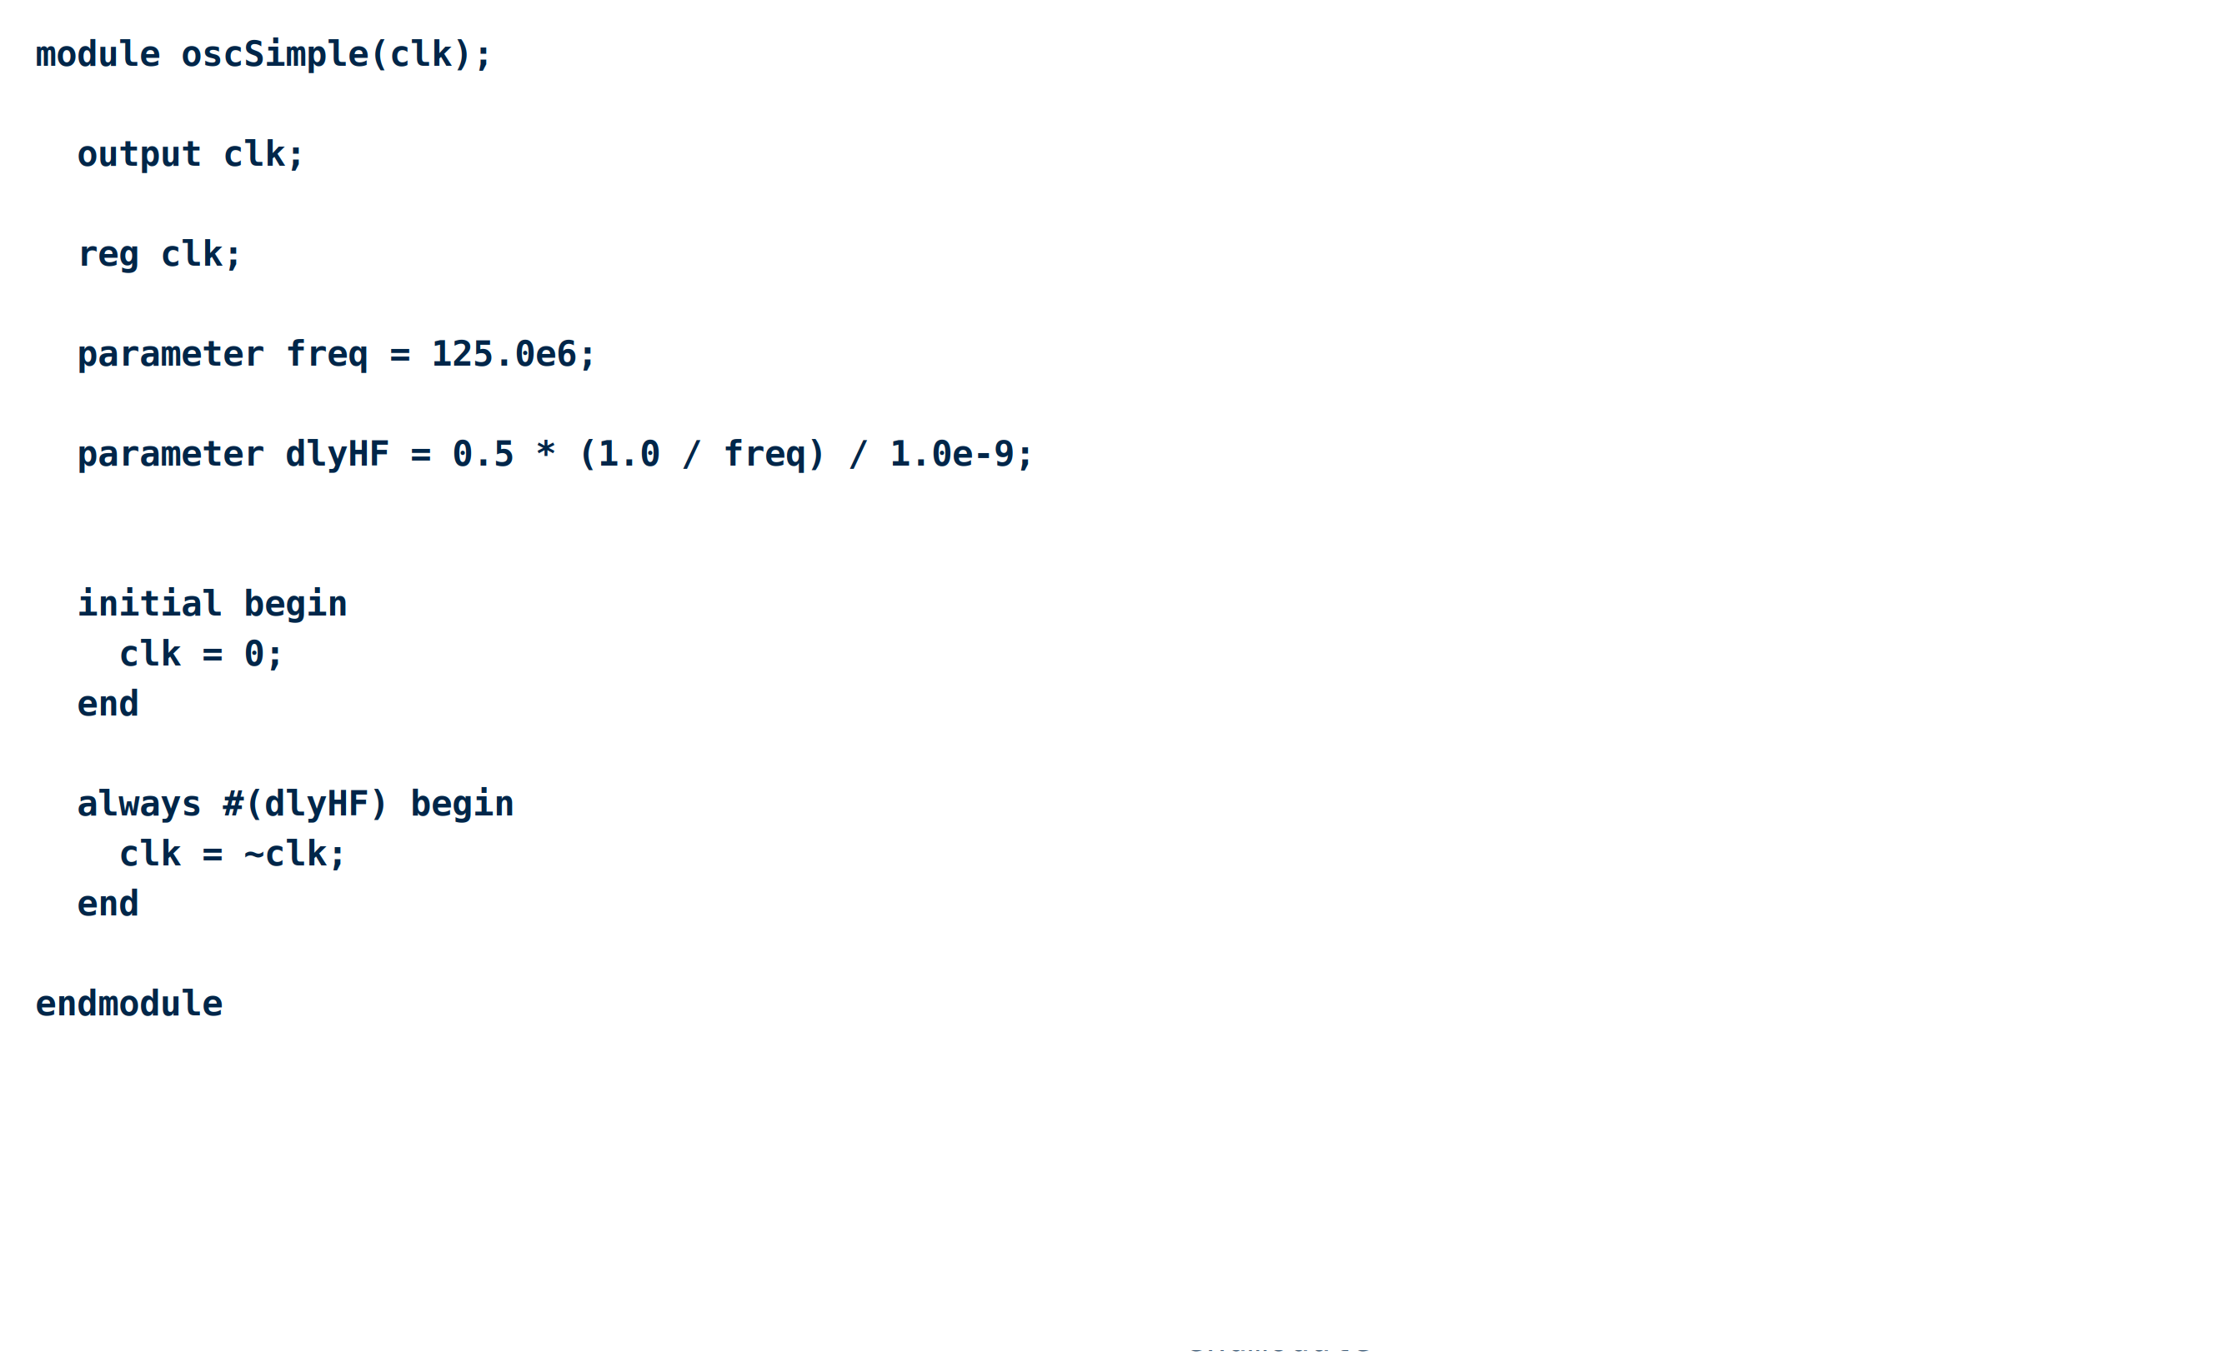
Verilog Code for Clock Sources

Slide 62
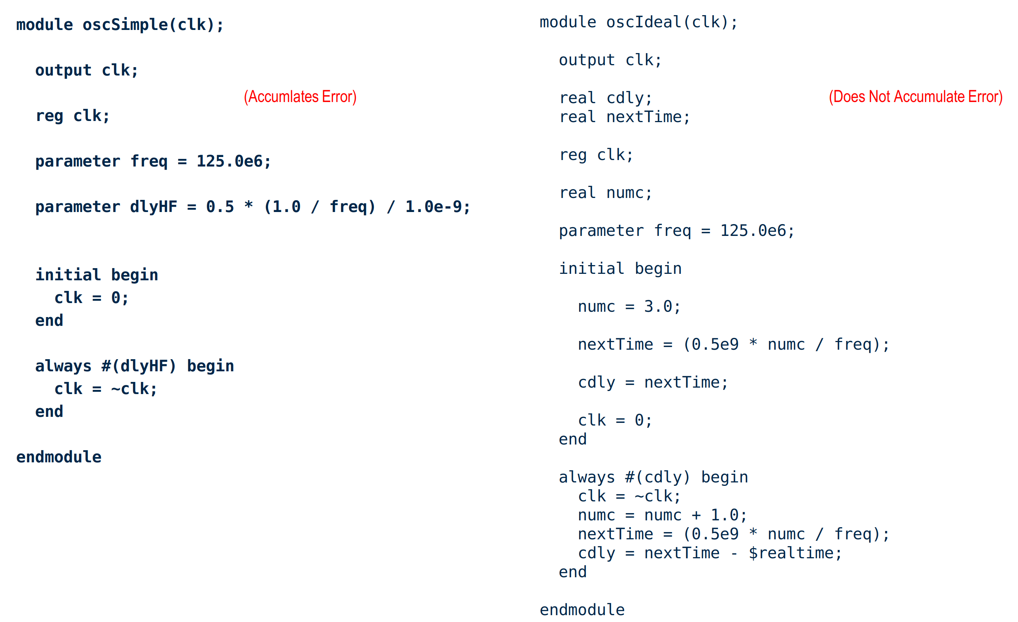
Verilog Code for Clock Sources

Slide 63
Verilog Code for Clock Sources
This little bit of code only uses reals to calculate nextTime, which thus has no snapping truncation error

Slide 64
Noise Model Strategy
  The “$random” verilog function produces a random 32-bit value
  We can make a uniform random value from -2²⁷ to 2²⁷
    $random % 134217728 (2²⁷ = 13417728)
    We can make a gaussian random number with a sigma of 2²⁷ by adding 12 of these and dividing by 2. (Scaling by 2²⁷ avoids the possibility of overflow when adding 12 of these together.
    Finally, we divide by 2²⁷ to get a random value with a sigma of 1.0
  The uniform random variable …
    Has its energy spread evenly from 0 to fs/2. C
    Can be passed through a low pass filter to create white noise with a desired cutoff frequency.
  We model 1/f noise by …
    Use three white noise sources summed in a stair-step fashion
    Typical cutoff frequencies of 100k, 1.0M, and 10.0M

Slide 65
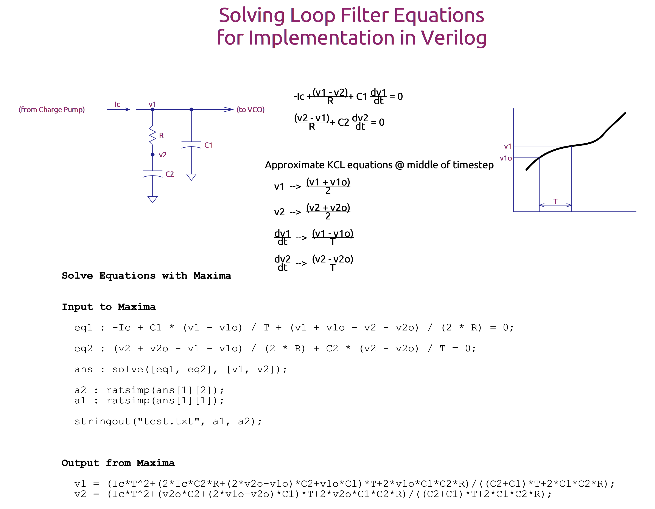

Slide 66
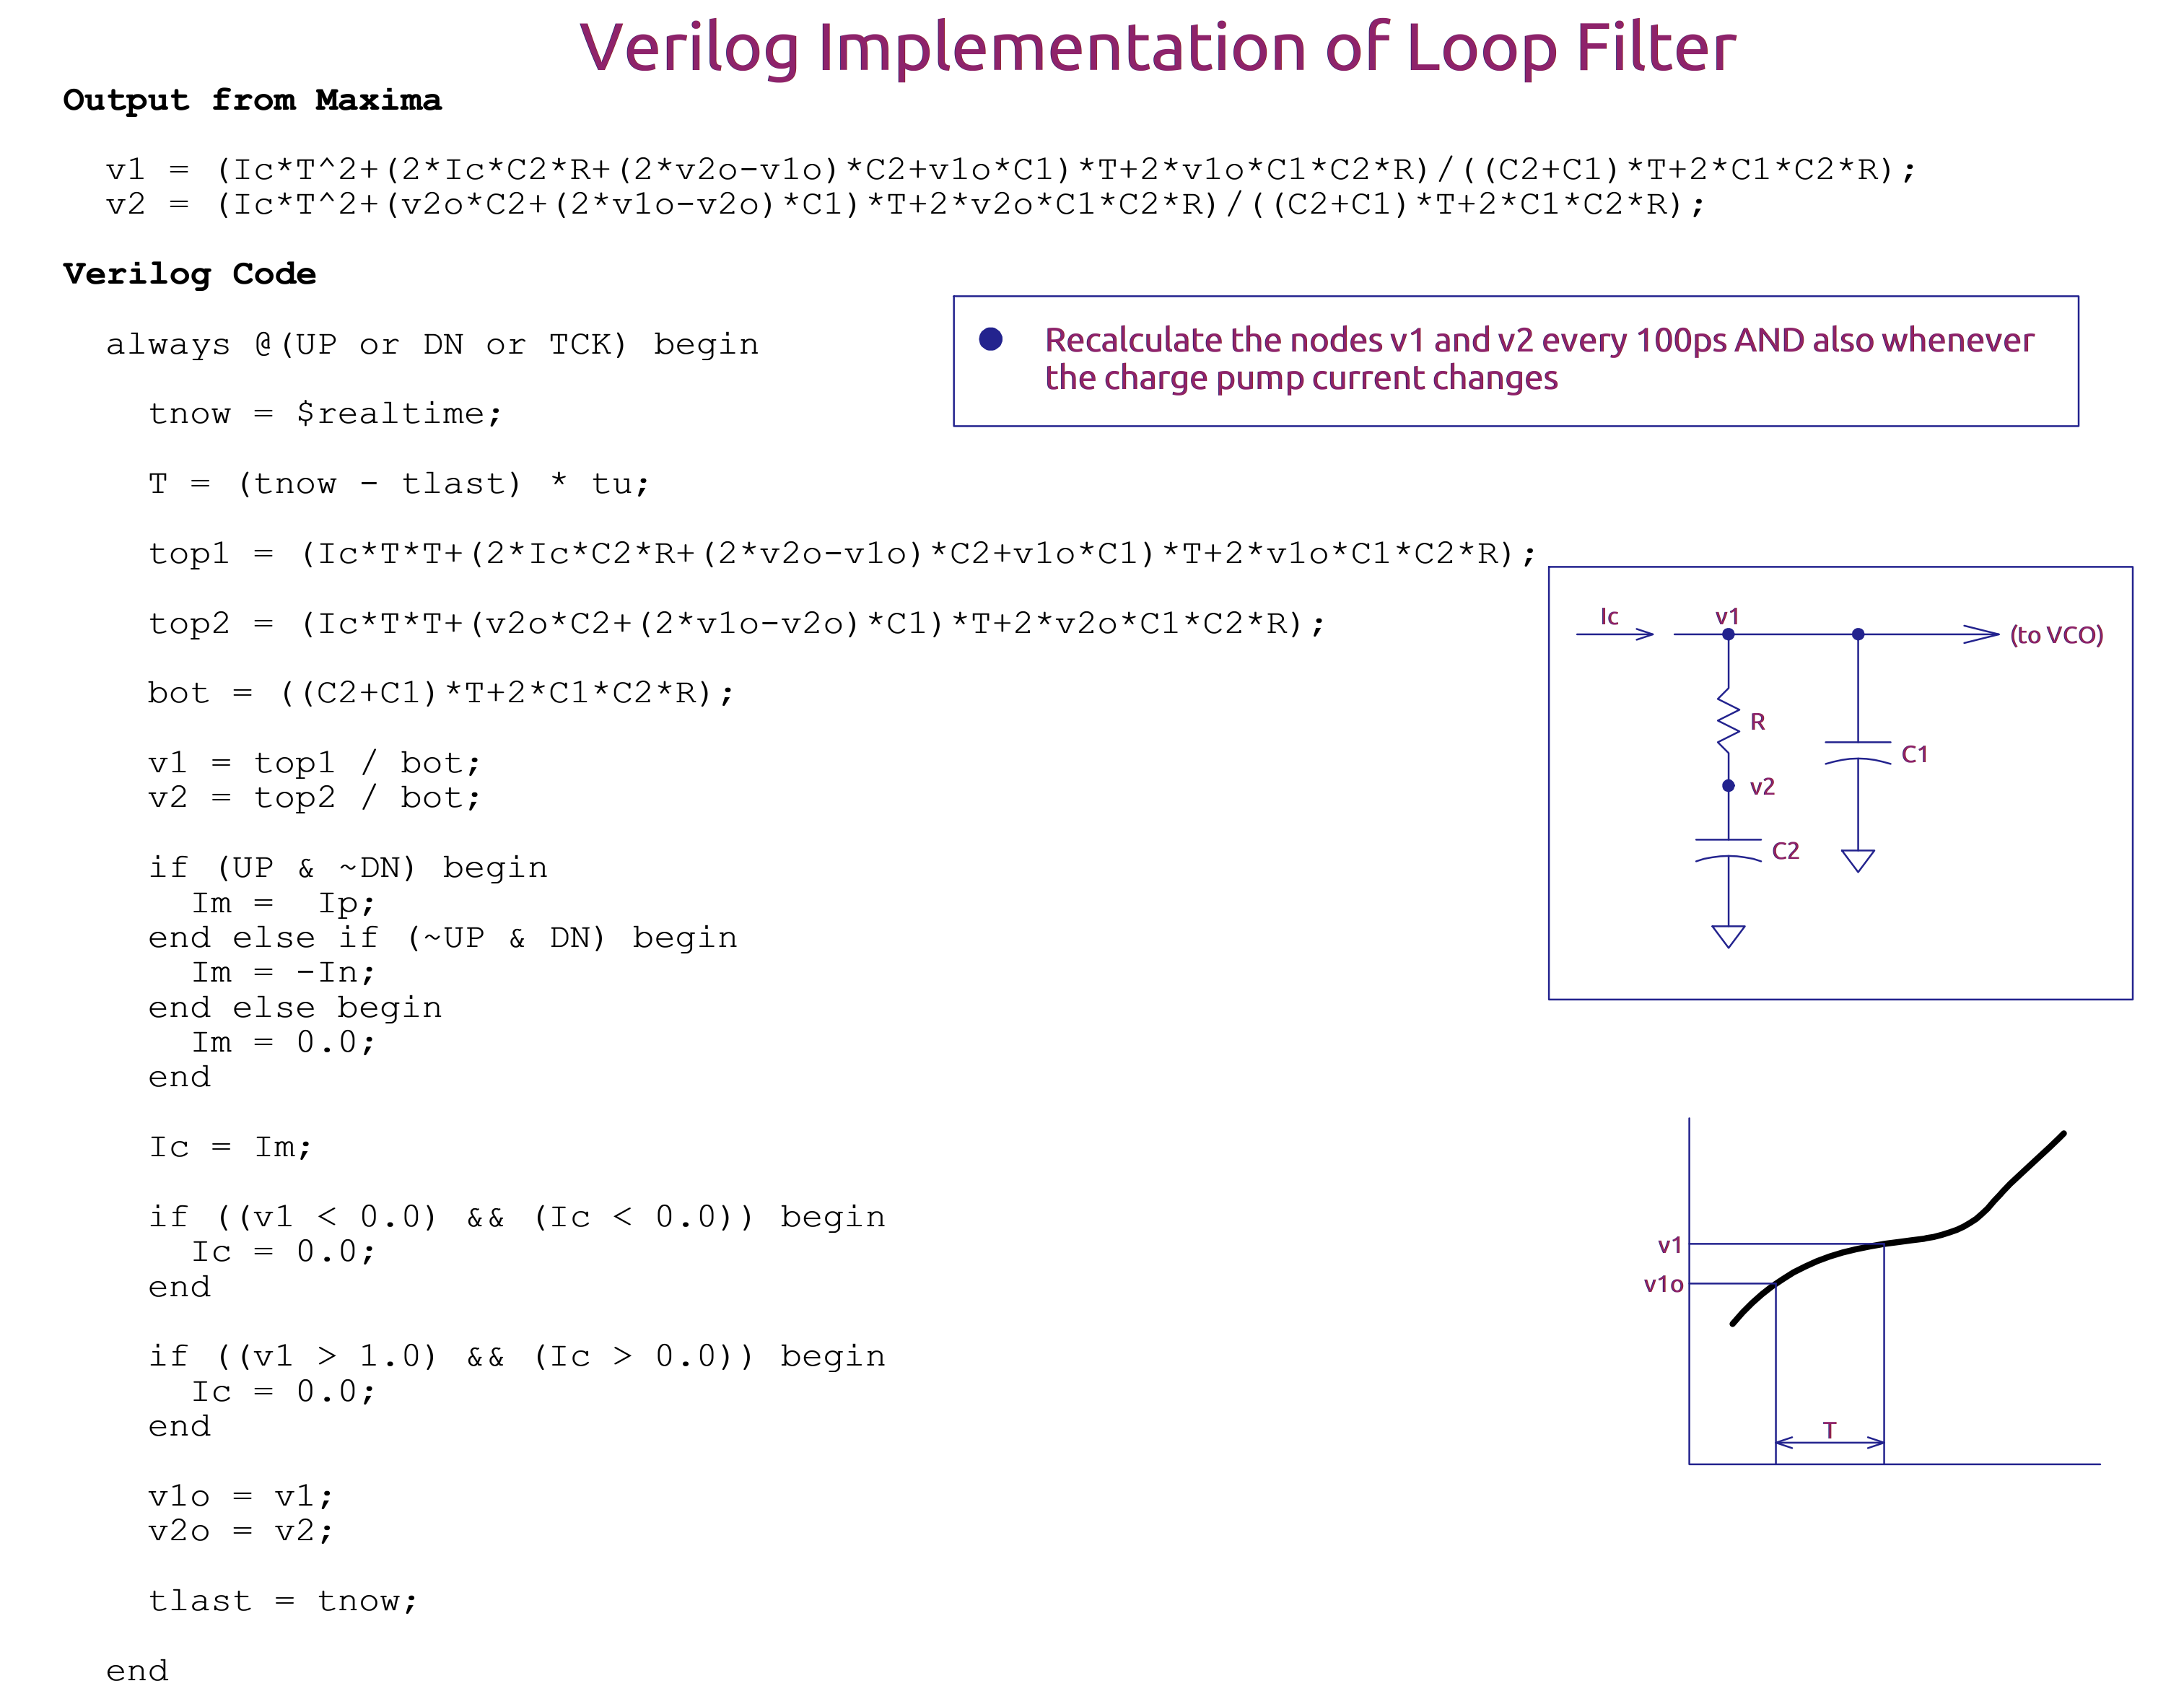

Slide 67
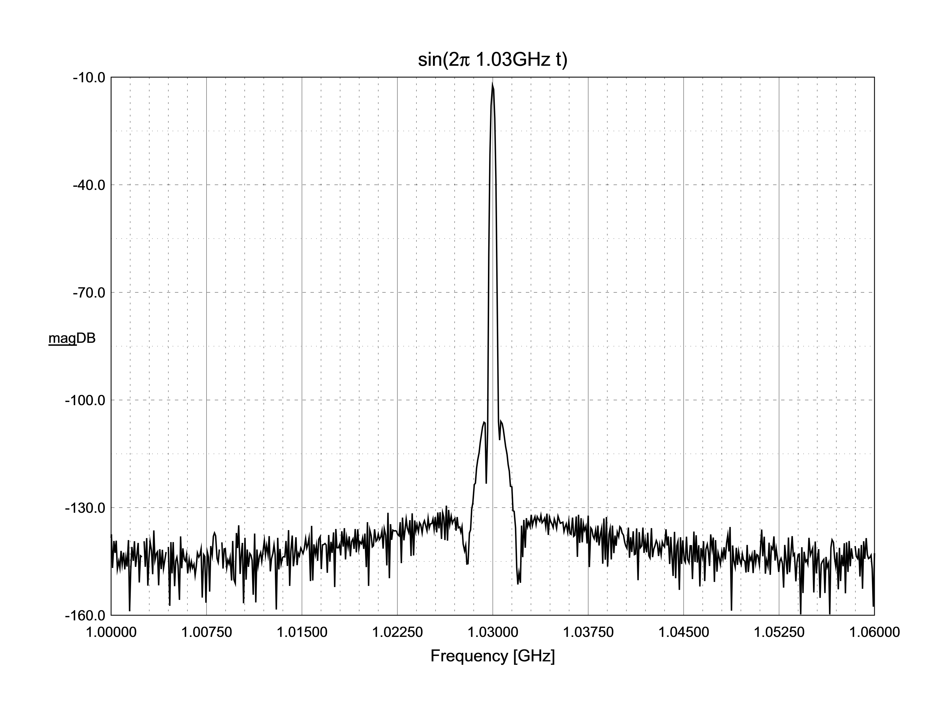

Slide 68
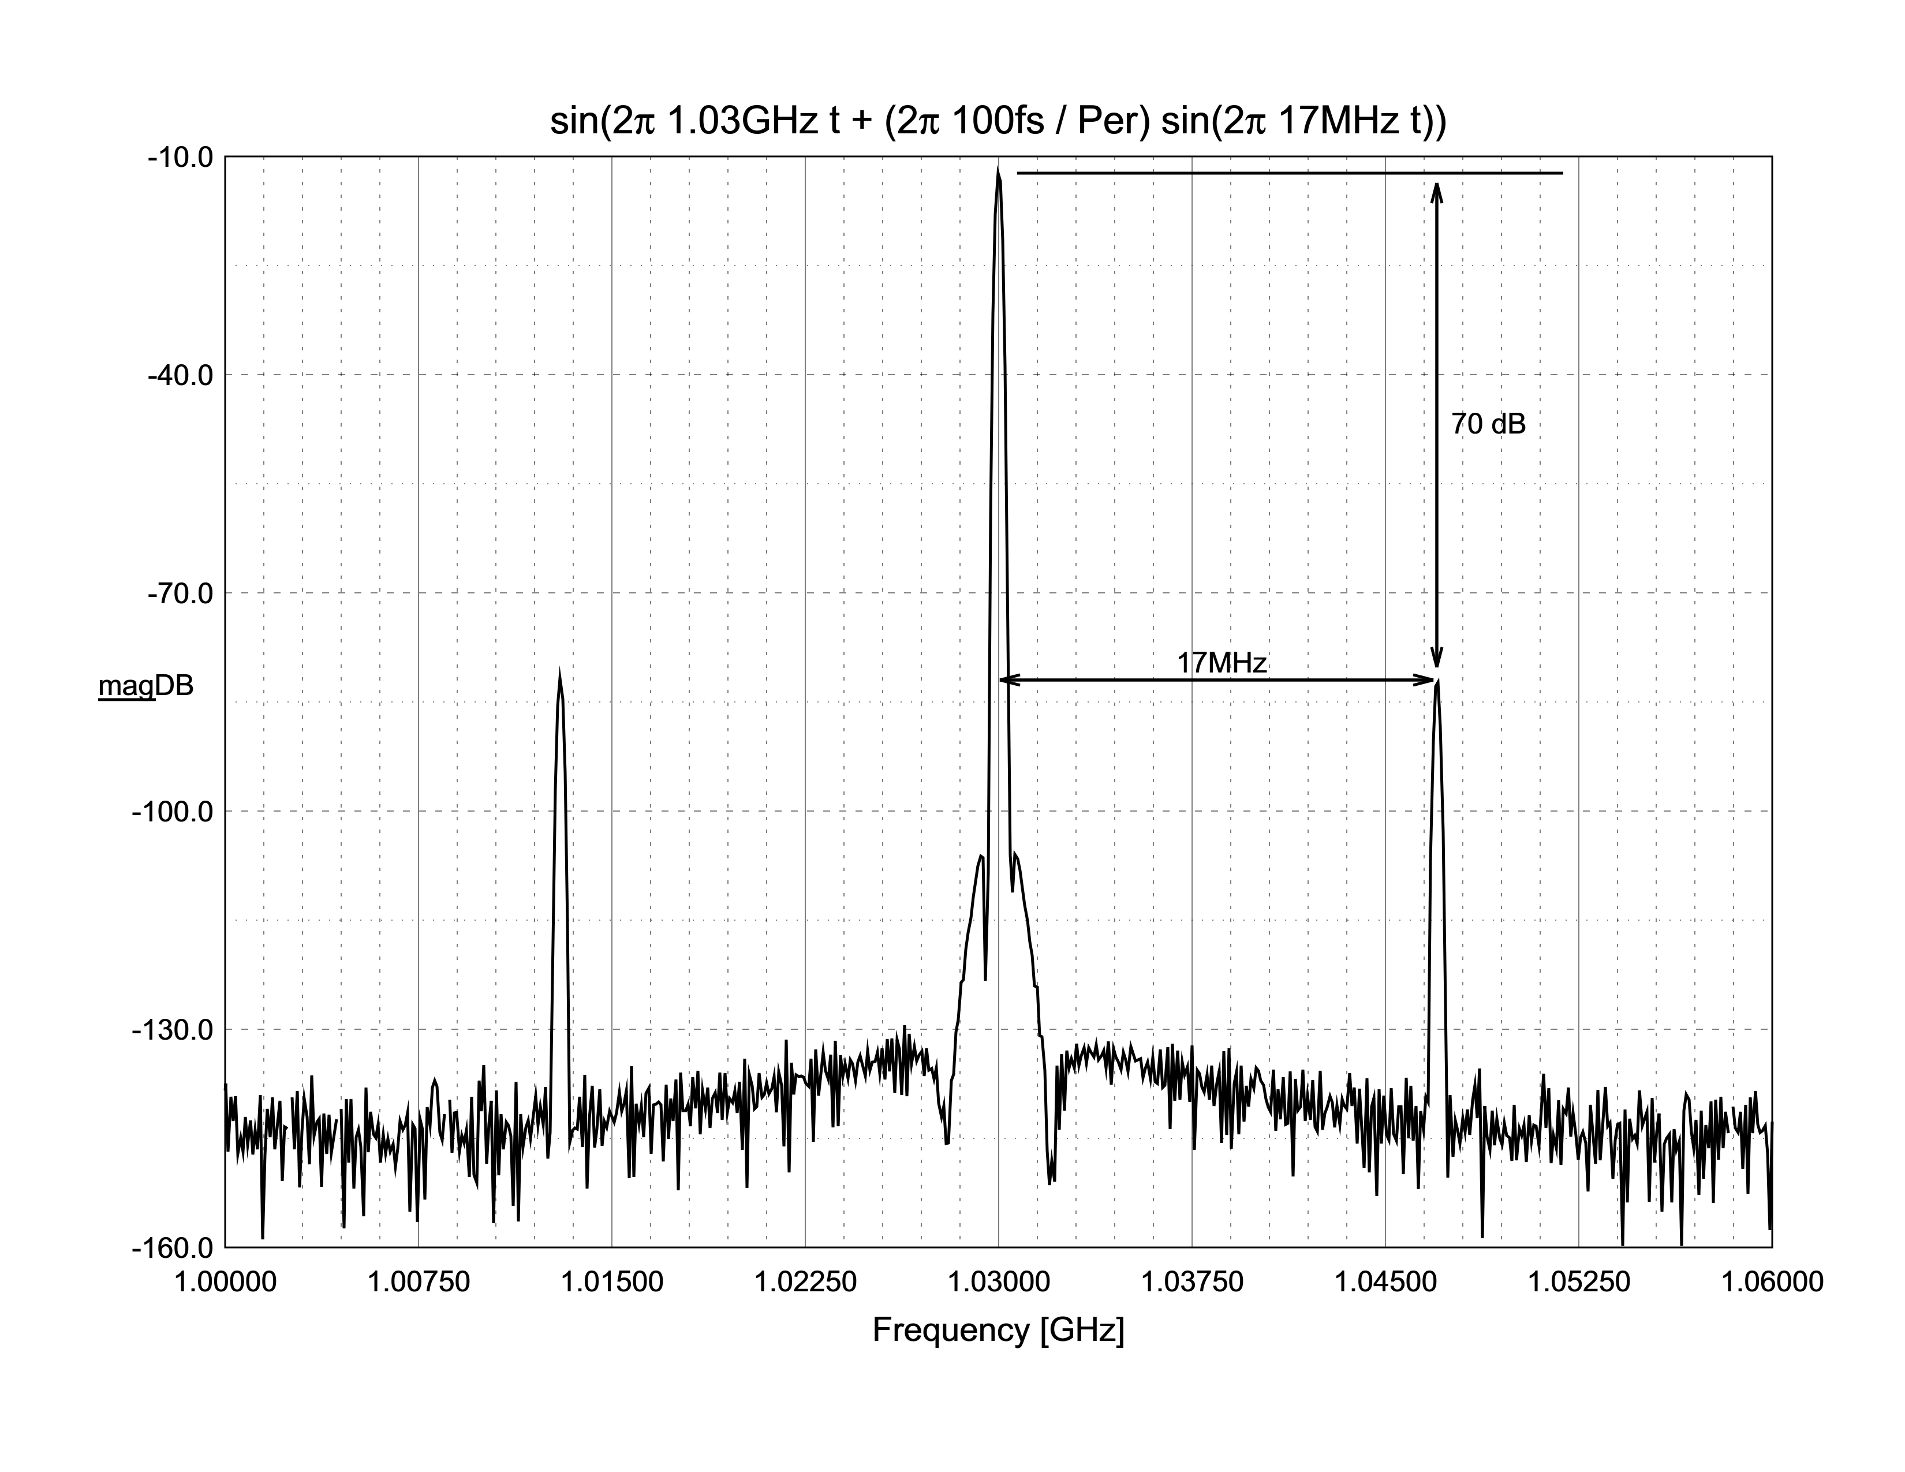

Slide 69
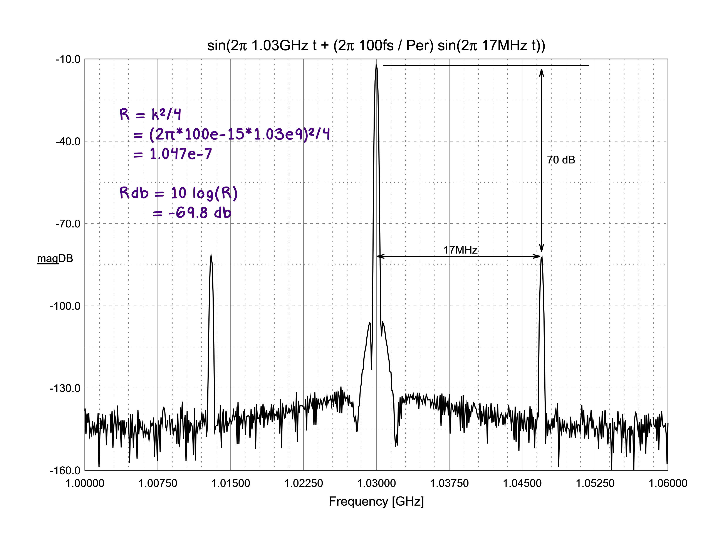

Slide 70
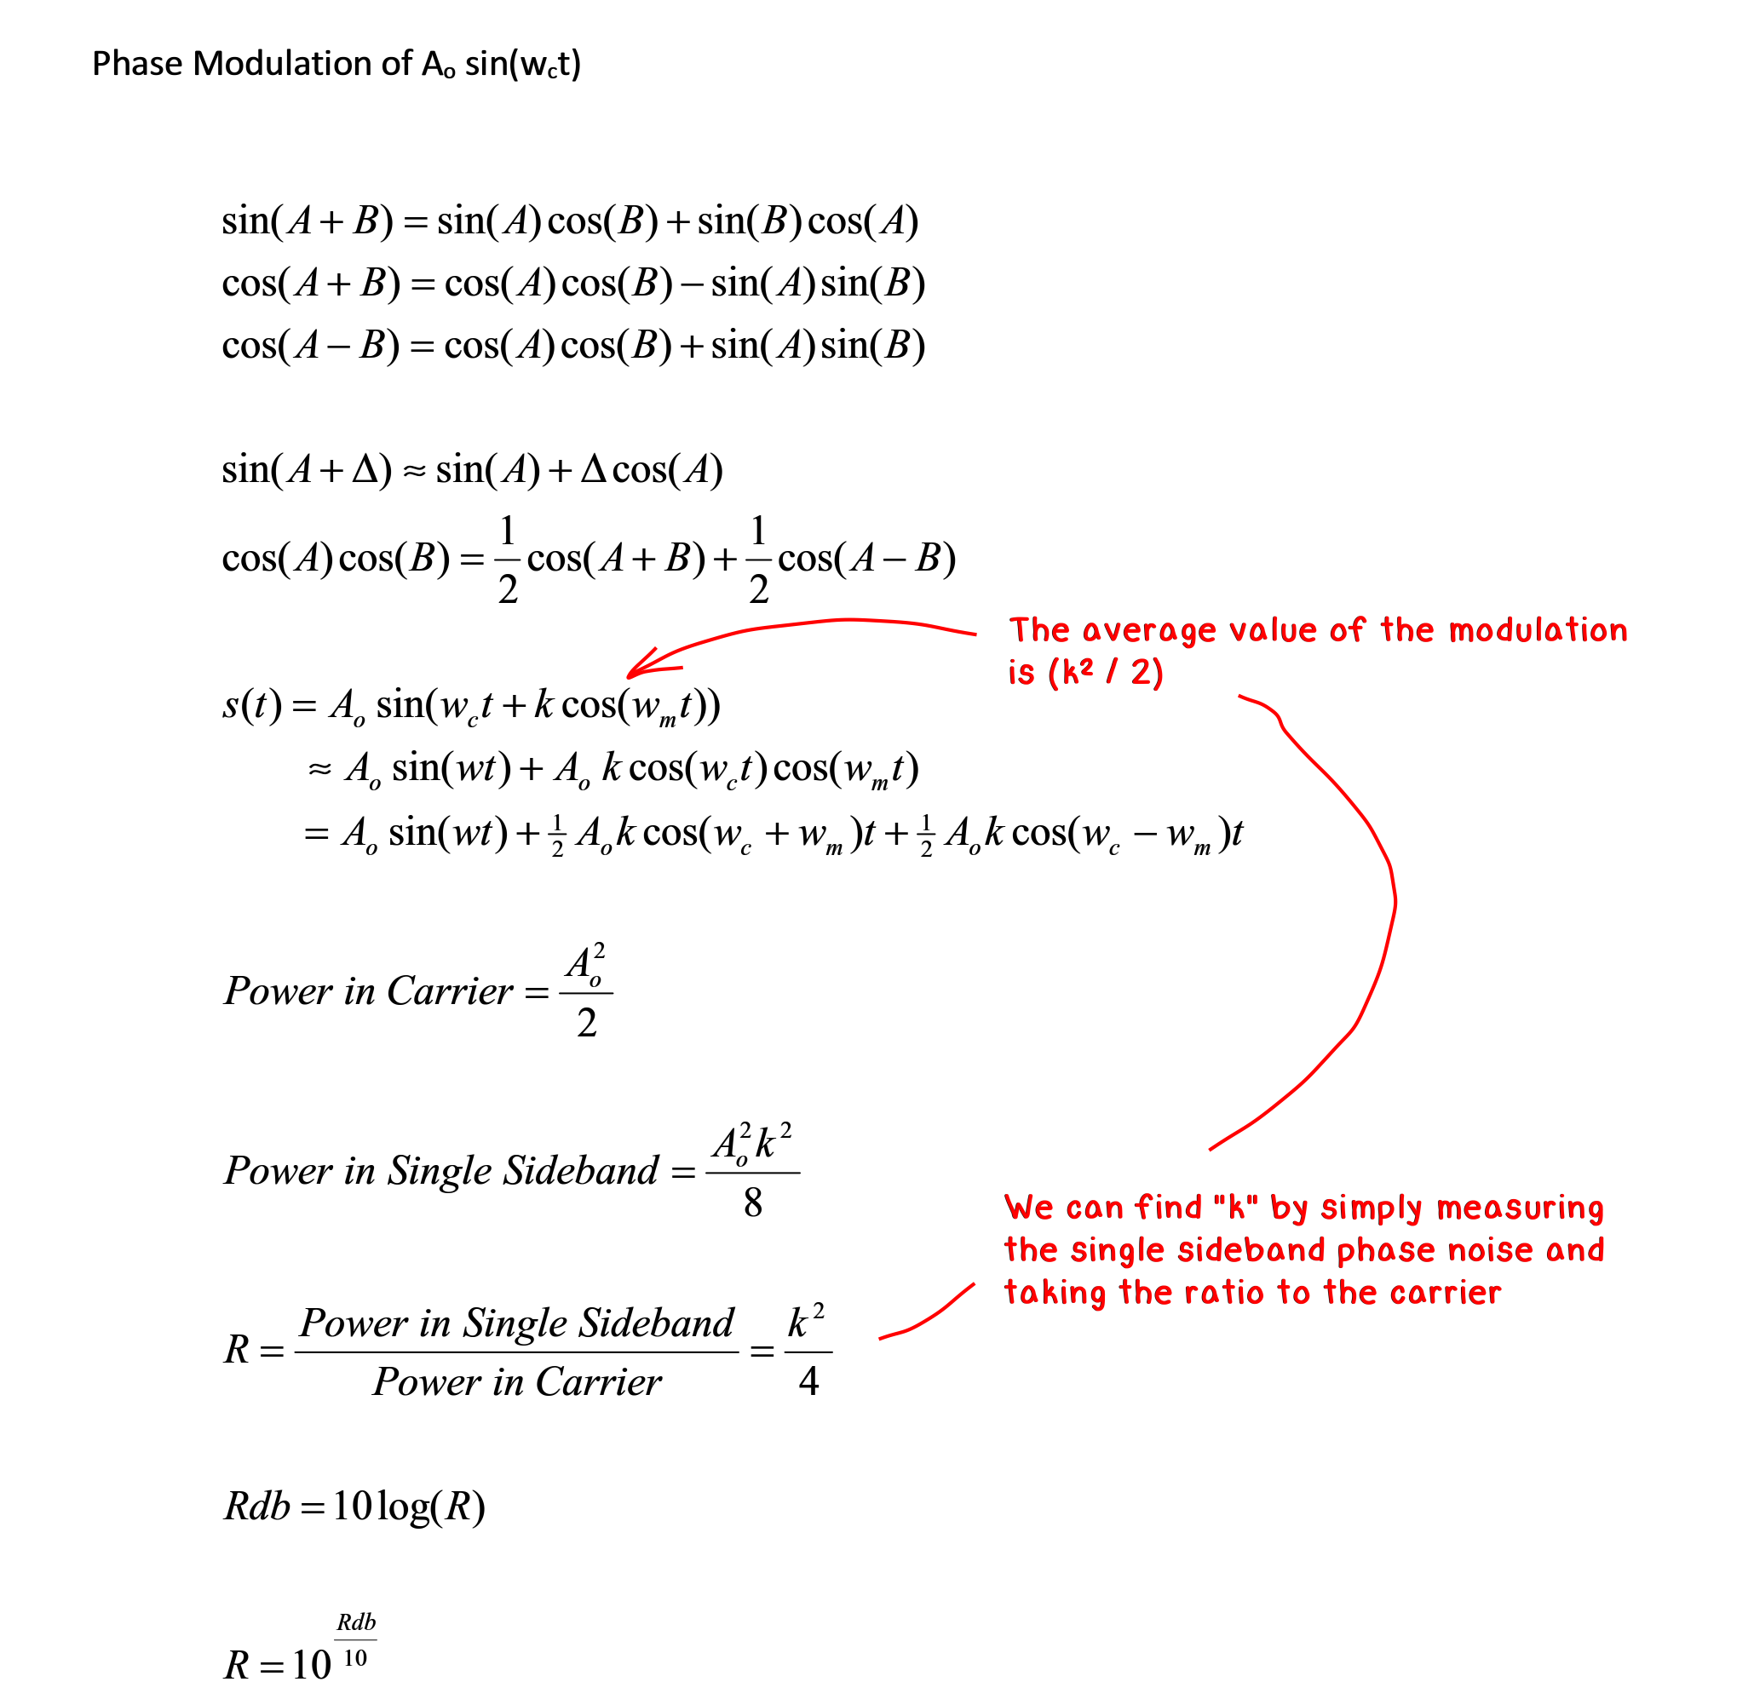

Slide 71
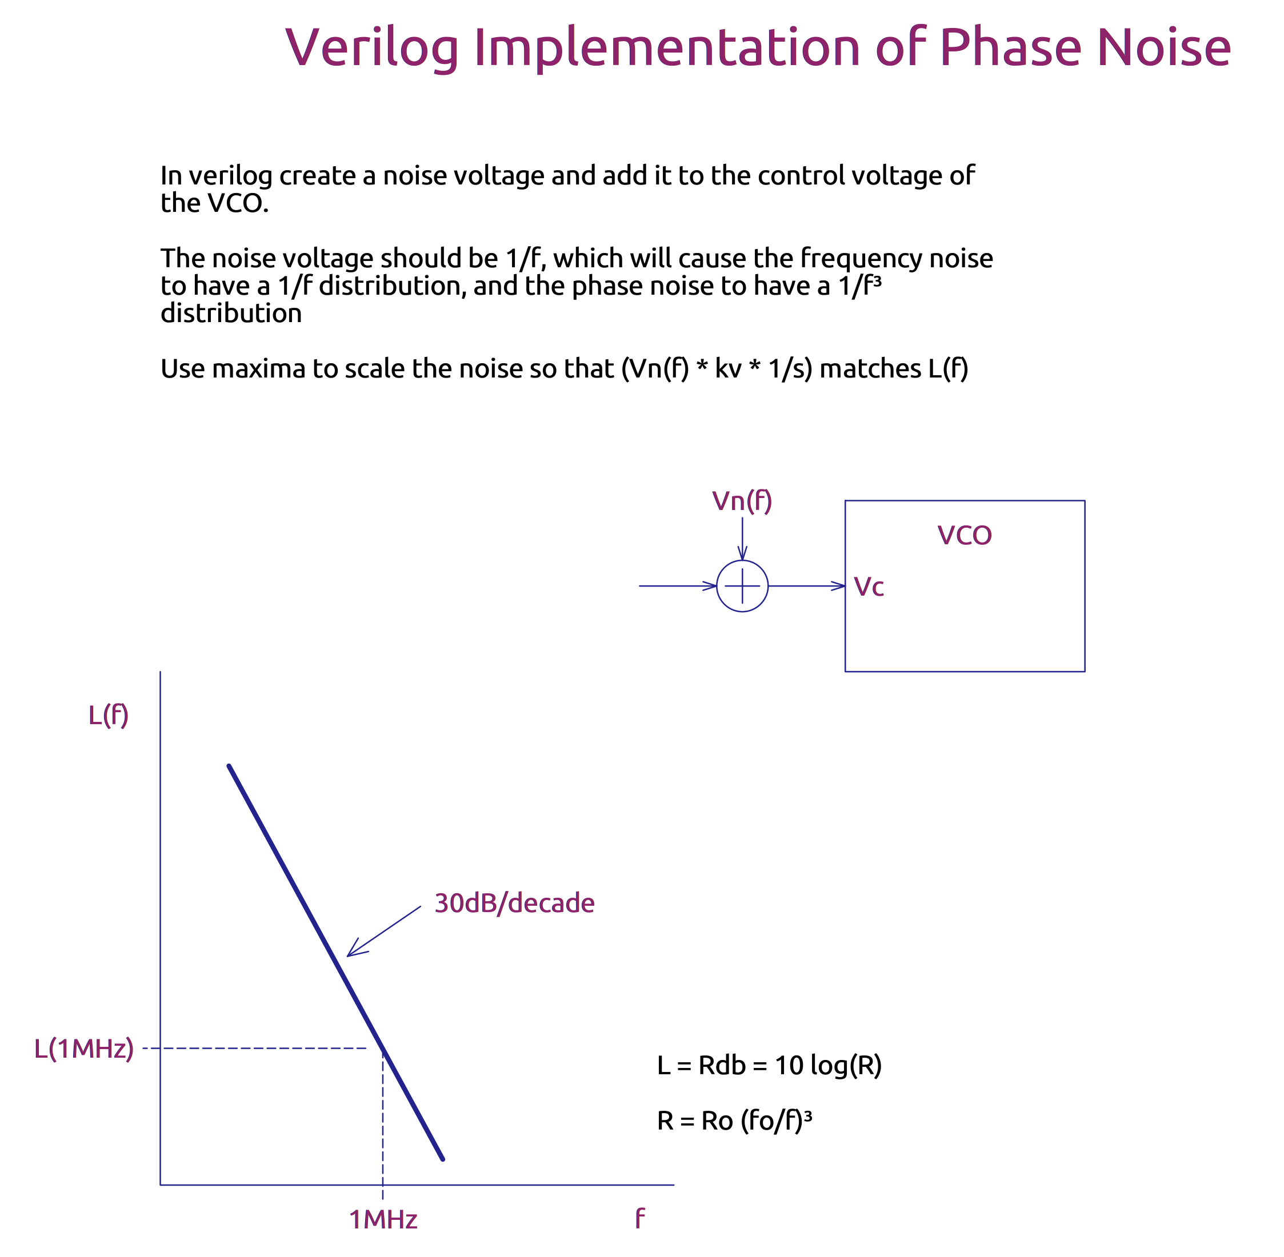

Slide 72
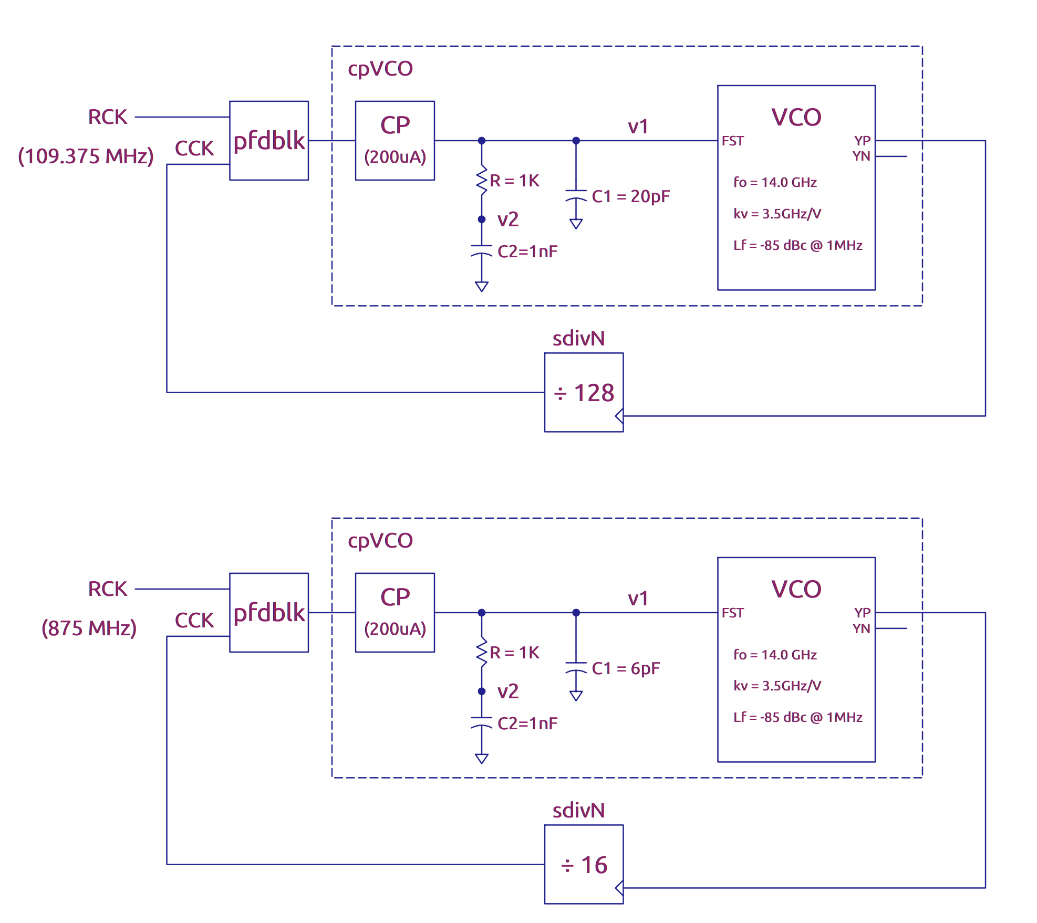

Slide 73
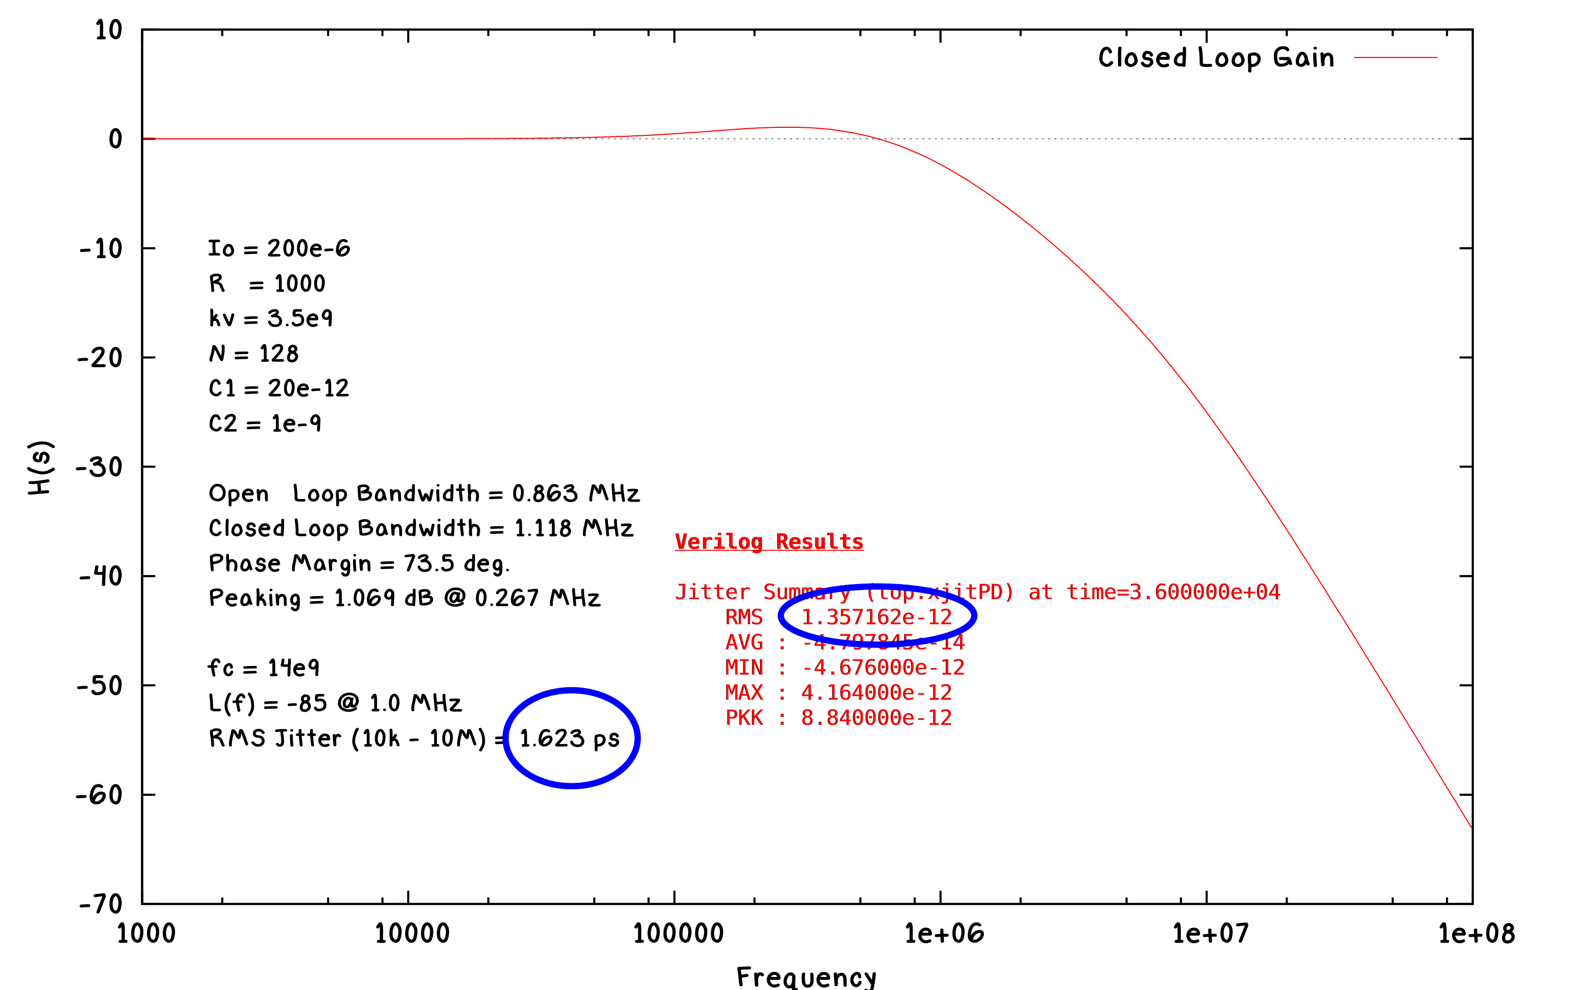

Slide 74
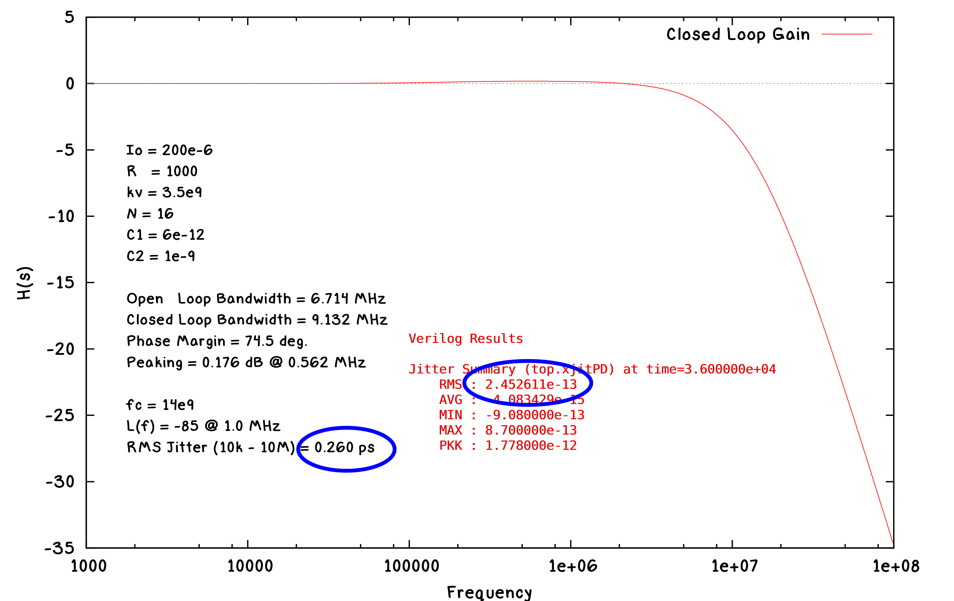

Slide 75
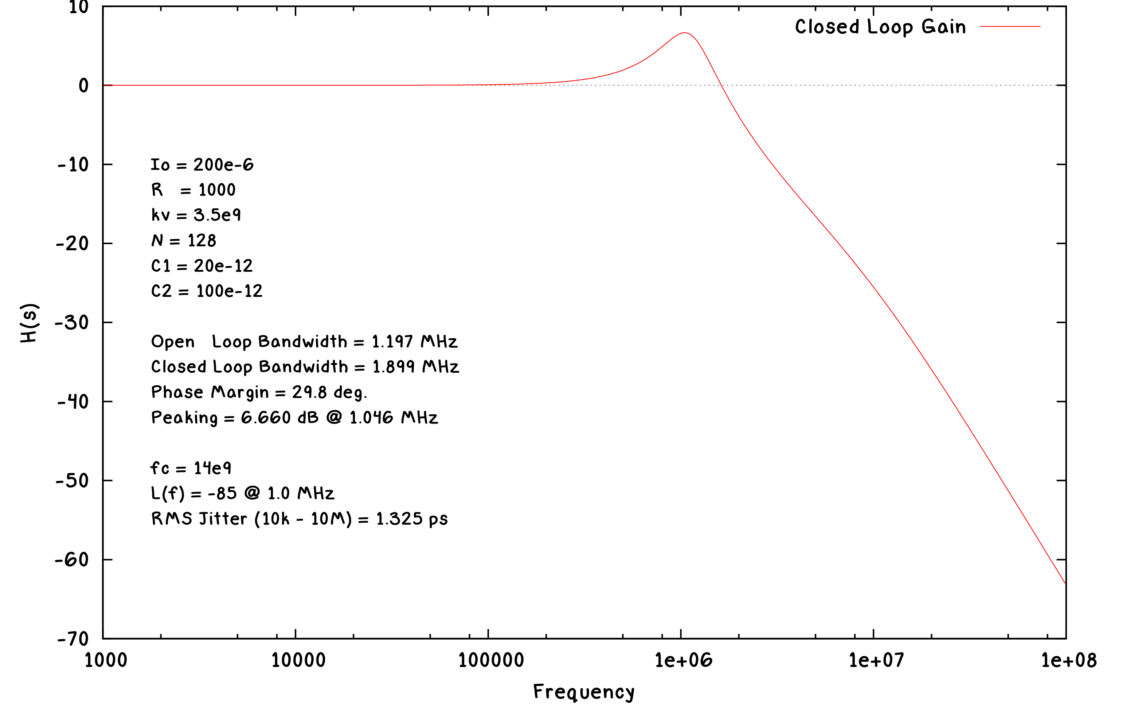

Slide 76
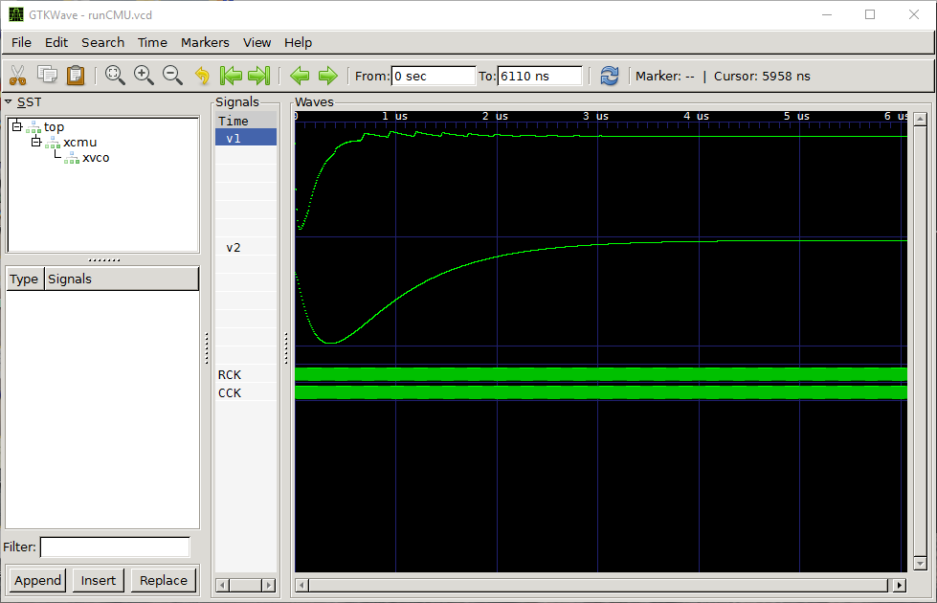
run1

Slide 77
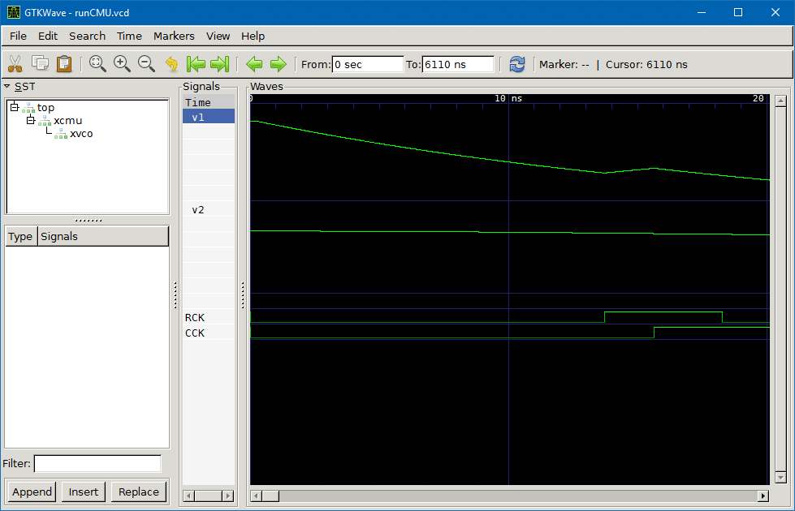
run1

Slide 78
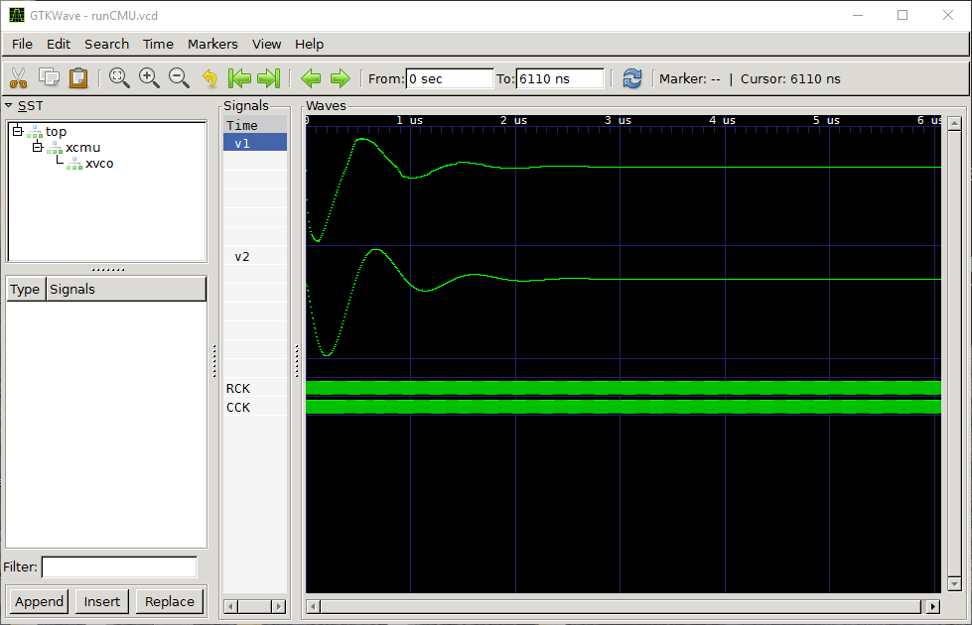
run2

Slide 79
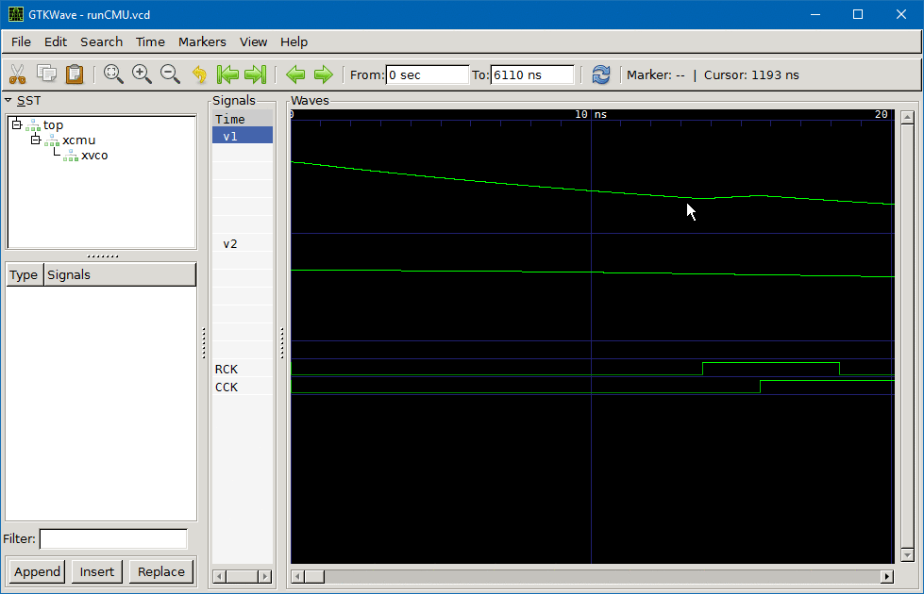
run2

Slide 80
Conclusion
  Verilog provides and ideal platform for studying precision timing circuits and systems
  Event driven simulation has significant advantages over an integration based solver (matrix solution)
    Well behaved and easily avoidable round off effects
    Orders of magnitude fasters for long simulations
    Compatible with chip level verification flow
  Verilog-A is similar in appearance to Verilog, but is still resides in the matrix based circuit simulation tools.
    Non-trivial to implement, and robustness varies widely
Thank you!

